Slide 1
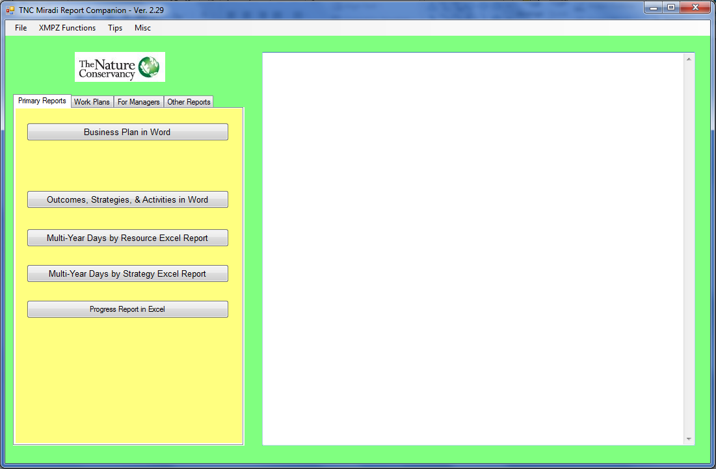
Miradi Report Companion App
The Miradi Report Companion is a desktop Application that automatically generates nicely formatted work plan, budget, progress reports in Excel and Conservation Business Plan and other reports in Word

Slide 2
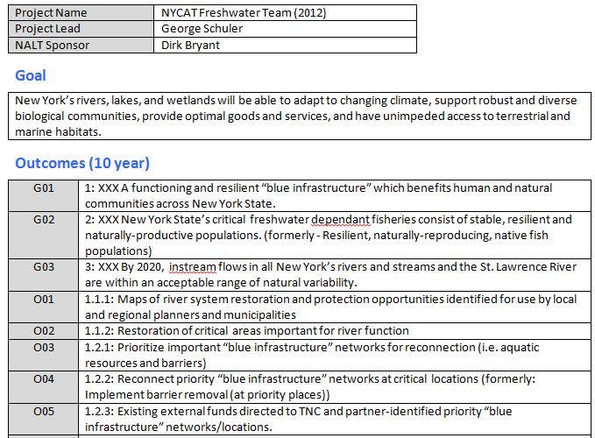
Outcomes, Strategies, and Activities in Word report
Top of outcome table – project contains additional outcomes – see next slide for Strategies and Activities table

Slide 3
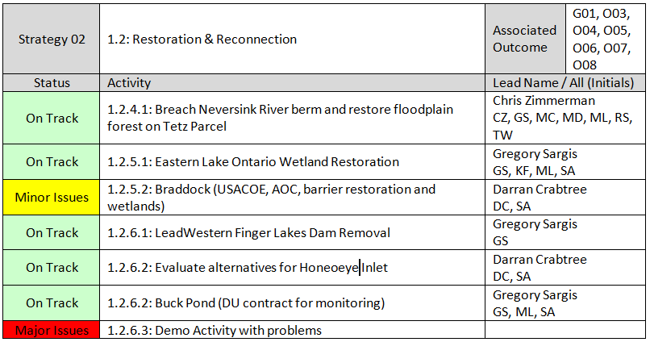
Outcomes, Strategies, and Activities in Word report
Second part of report – see previous slide for table of Outcomes

Slide 4
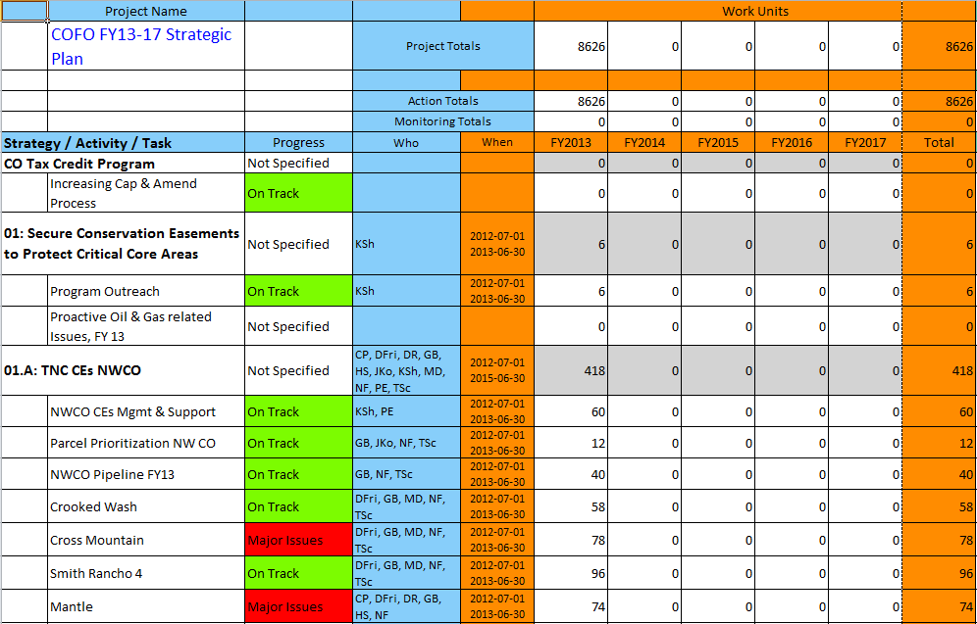
Basic Work Plan Table
Work days by Strategy & Activity by fiscal year (with progress ratings as well). Totals at top.

Slide 5
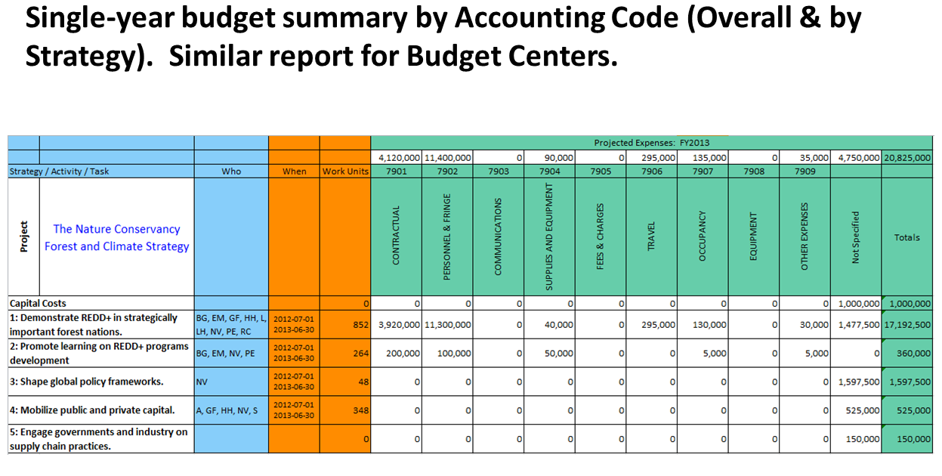

Slide 6
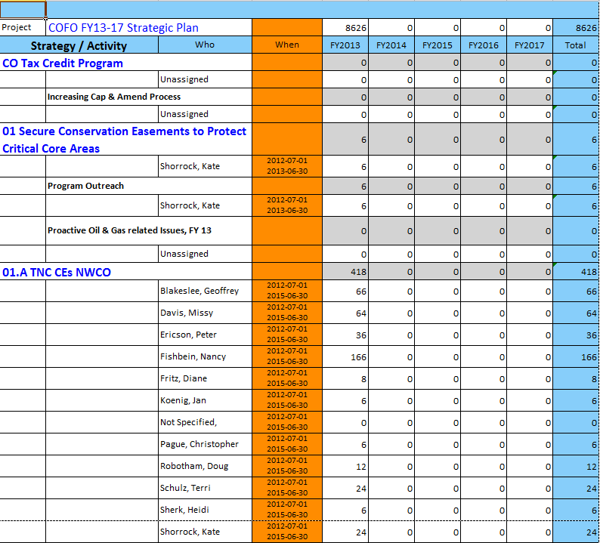
Multi-year Work Plan by Strategy with all staff work days

Slide 7
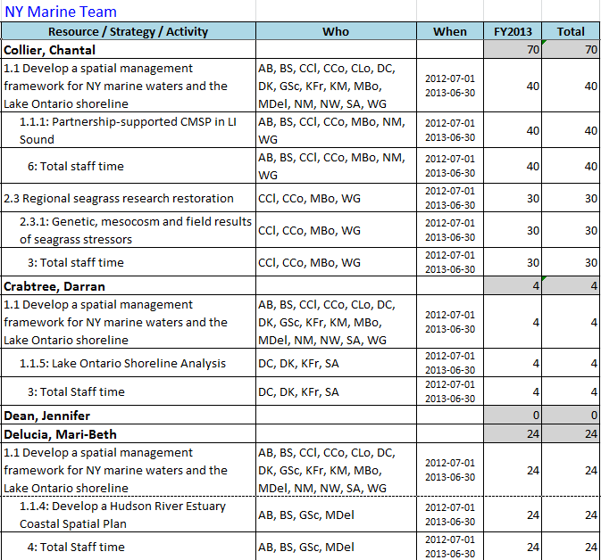
Multi-year Work Plan by Staff Resource with all staff work days
Only lists strategies and activities involving the bolded staff person

Slide 8
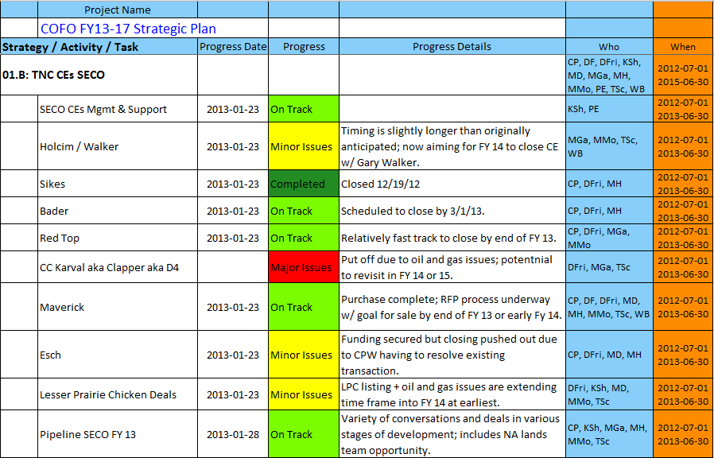
Progress Ratings with comments and Who and When information

Slide 9
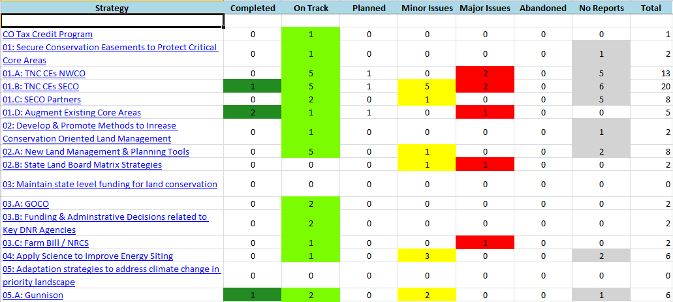
Tally of Activities by Progress Category for a single project

Slide 10
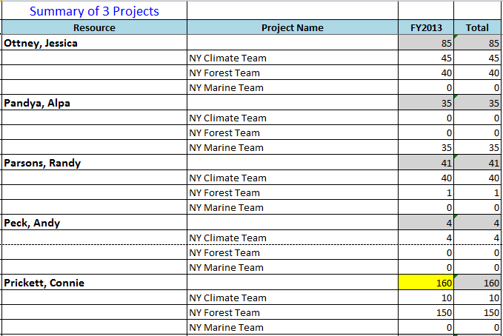
Roll-up report of total work days by staff person across 3 projects

