Slide 1
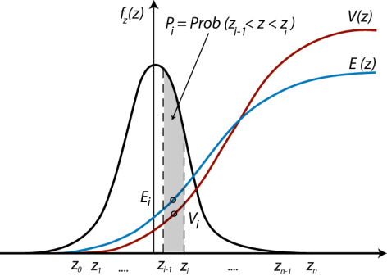
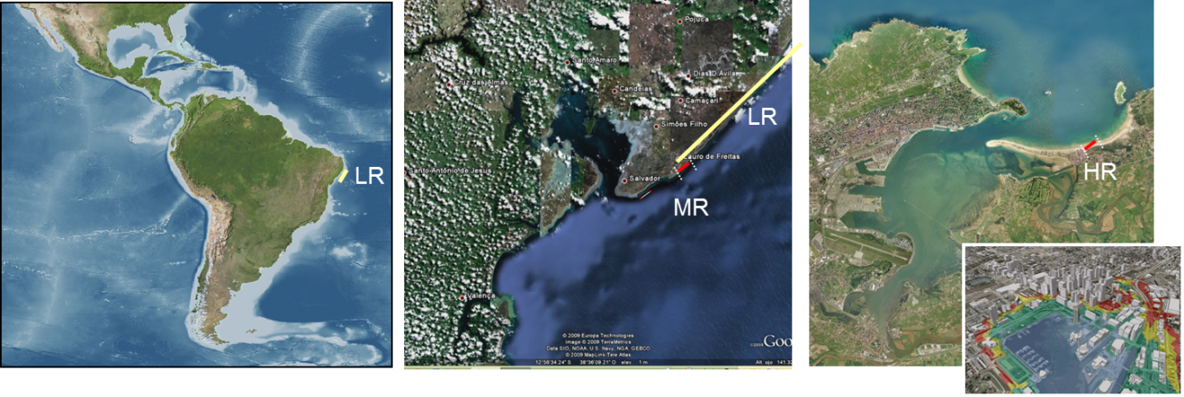


Coastal Risk Assessment studies:
The problem of the scales through 3 examples
Borja G. Reguero
gonzalezrb@unican.es / breguero@ucsc.edu

Slide 2
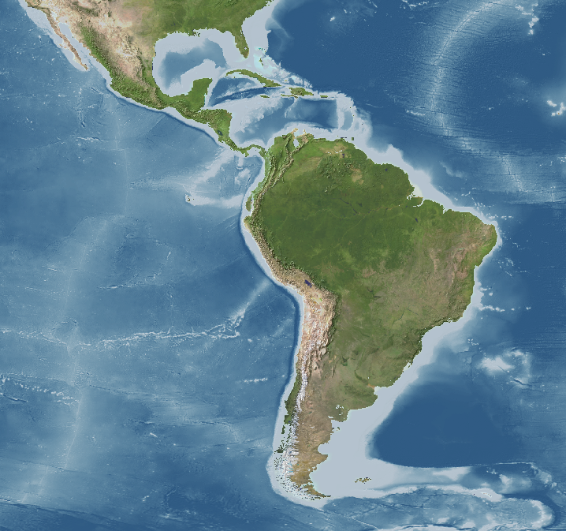
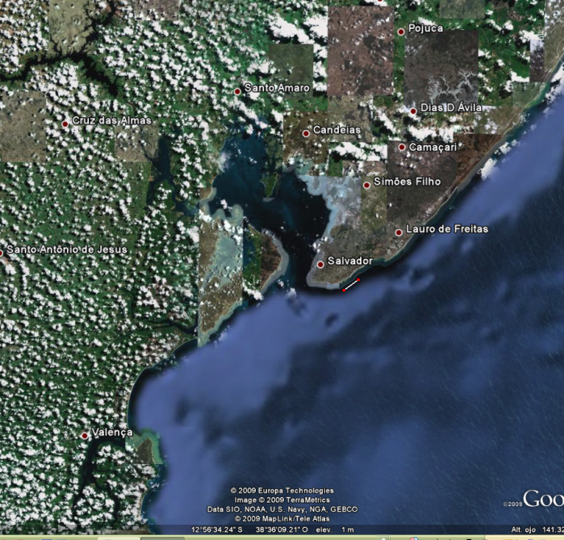
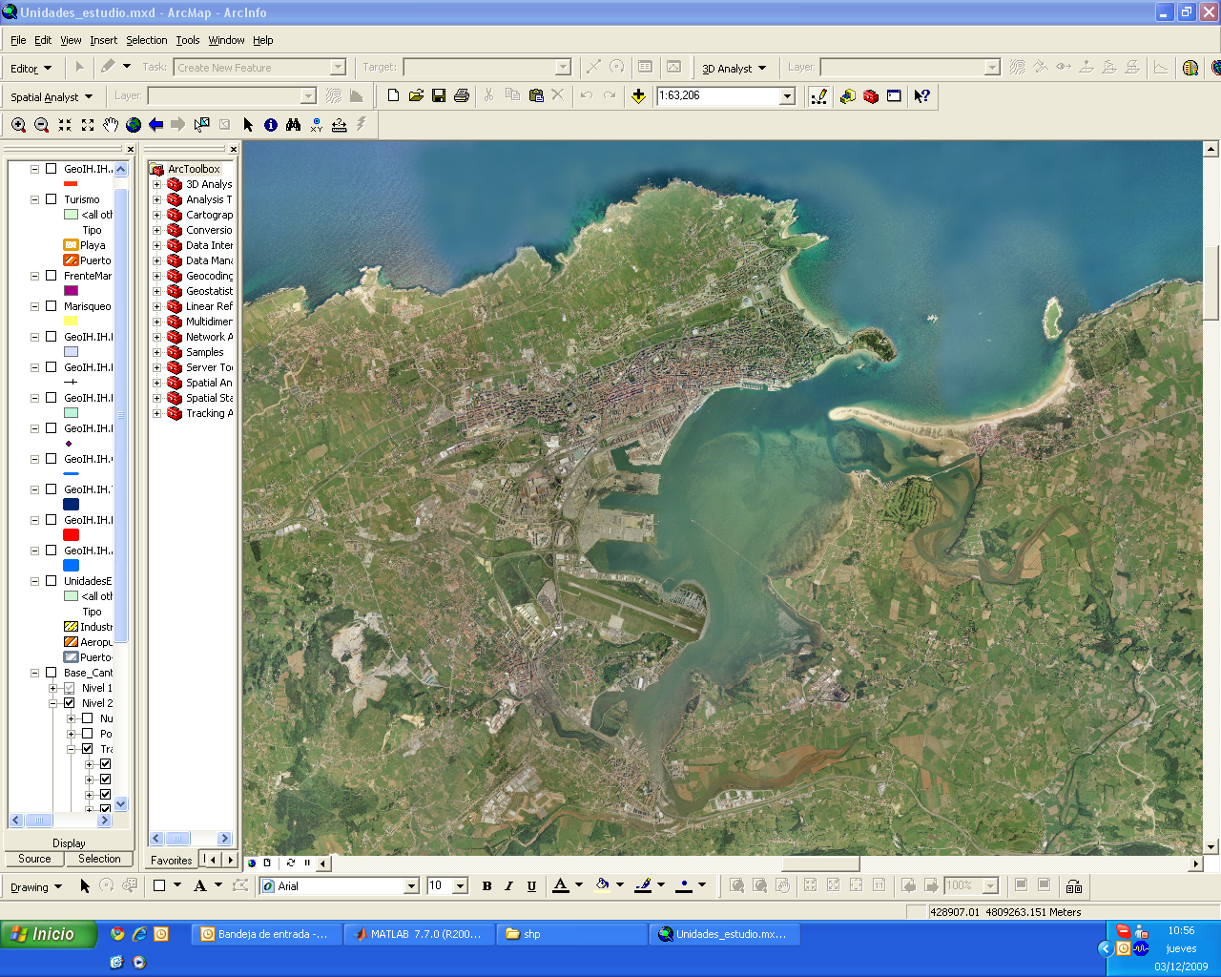
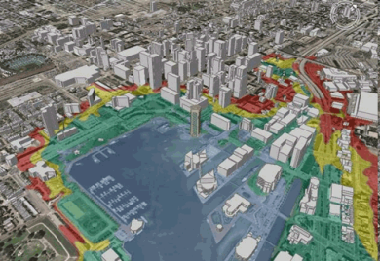
3 scales
Spatial scales in the coastal areas:
  0.50º ~ 50 Km = Global (Low Resolution, LR)
  0.05º ~ 5 Km = Regional (Medium Resolution, MR)
  10 m – 100 m = Local (High Resolution, HR)
LR
LR
HR
MR
National / International
e.g., LAC
Country / region
e.g. Gulf Coast, US
Local site
e.g., city
Data + detail/resolution of processes

Slide 3
Case 1. The Macro Scale: e.g., Latin America and the Caribbean
Case 2. The Micro Scale: e.g., The city of Santander (SP)
Case 3. The Meso Scale: e.g., Gulf Coast

Slide 4
Case 1. The Macro Scale: e.g., Latin America and the Caribbean
Case 2. The Micro Scale: e.g., The city of Santander (SP)
Case 3. The Meso Scale: e.g., Gulf Coast
“ Identifying priorities“
(process-integrated approach)

Slide 5

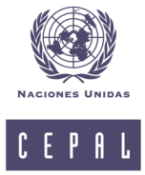

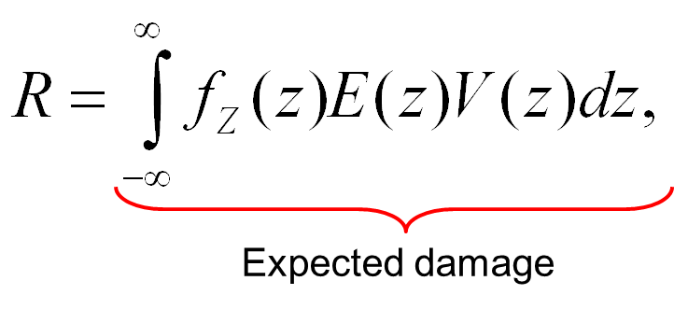
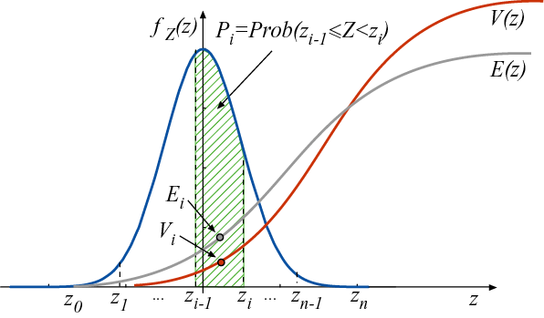
Regional study on the effects of Climate Change in the coast of Latin America and the Caribbean
European Commission terminology (Schneiderbauer and Ehrlich, 2004)
Risk (R) is defined as “the probability of harmful consequences or expected losses resulting from a given hazard to a given element at danger or peril, over a specified time period”
(Natural Disasters)
Vulnerability
Exposure
Hazard value

Slide 6
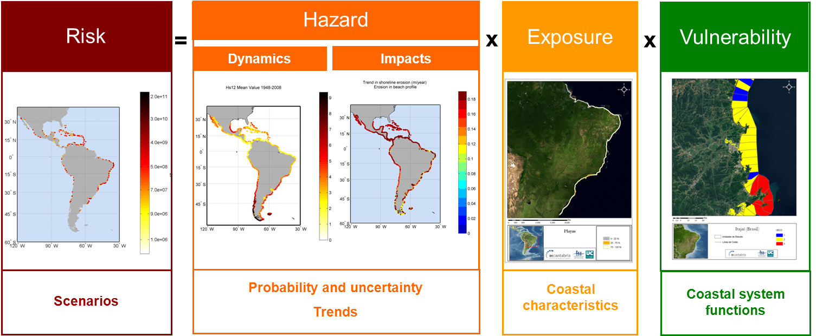
Regional study on the effects of Climate Change in the coast of Latin America and the Caribbean

Slide 7
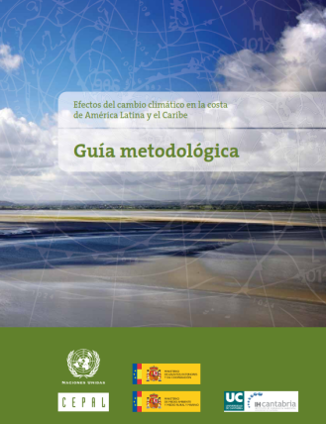
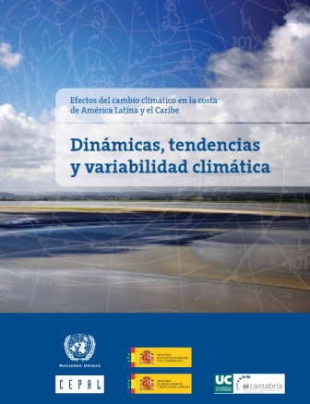
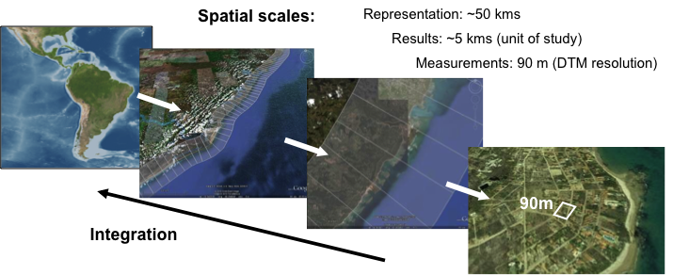
Hazards (Dynamics & Impacts)
Exposure & Vulnerability
Risk
Distribution of population
Ecological vulnerability indices
Beach erosion (Tourism and coastal protection)
Coral Bleaching
Coastal typology (beach characteristics, coastal defense, port facilities, city sea border)
Ecosystems clasification
Coastal flooding
Port (operability and reliability)
Waves
Storm surge
Sea Level Rise
Sea Surface Temperature
Surface Air Temperature
Salinity
…
Land uses and surface affected
Infrastructures (Roads & Railways)
…
…
  Coastal Flooding
  Beach Erosion
  Port activity and reliability
  Coral Bleaching
  Sediment potential transport
  Eolic potential transport
Dynamics
Impacts

Slide 8
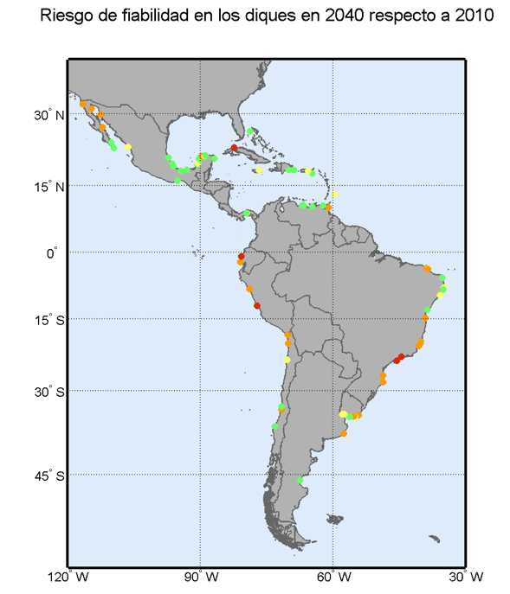
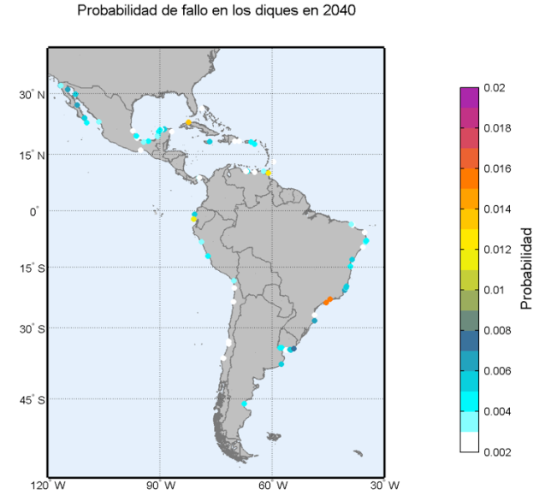
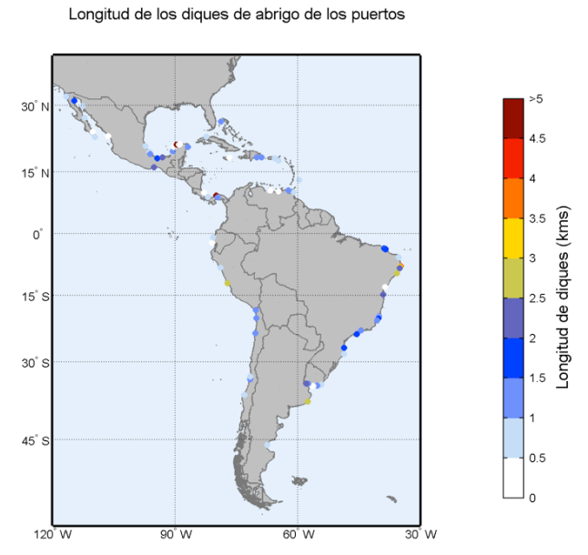
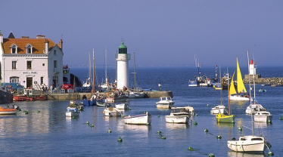
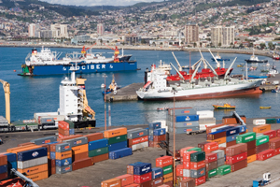
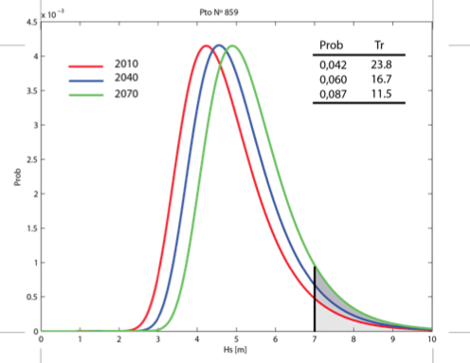
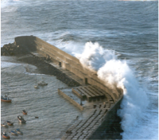
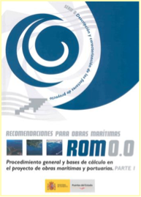
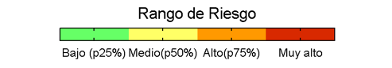
Example of Risk integration 2:
Reliability of Defensive Breakwaters
Type of sea-port as a function of its socio-economic relevance
Hazard
Exposure
Vulnerability
Length to repair
Change in design probability level

Slide 9
Case 1. The Macro Scale: e.g., Latin America and the Caribbean
Case 2. The Micro Scale: e.g., The city of Santander (SP)
Case 3. The Meso Scale: e.g., Gulf Coast
“ Going to the detail “
(process based approach)

Slide 10
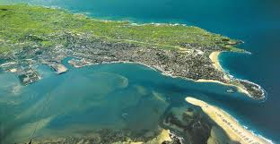
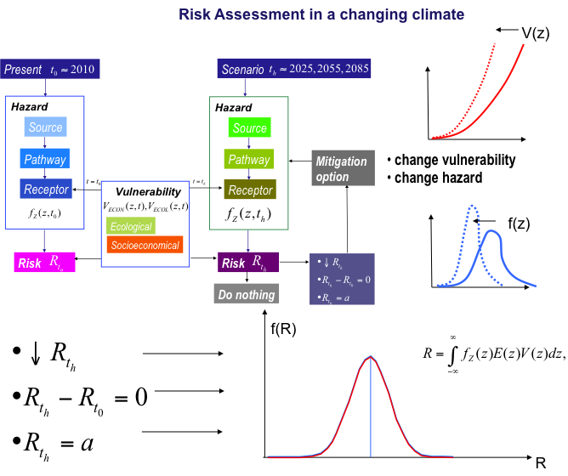
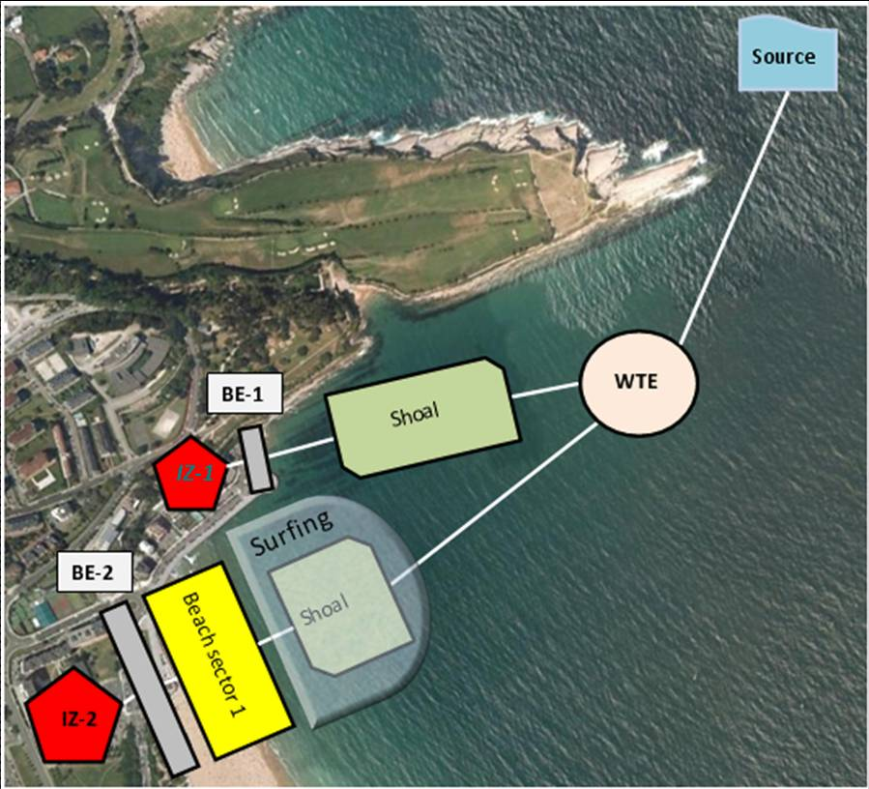
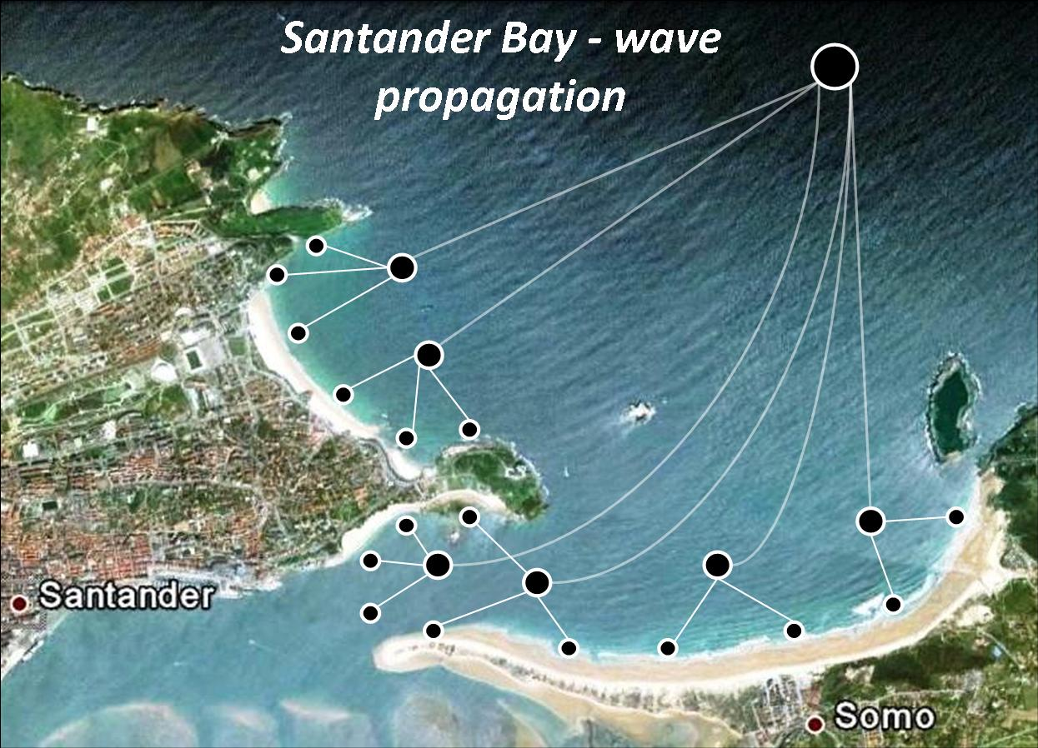



DSS-Santander follows the SPRC methodology
(Source, Pathway, Receptor, Consequences)
change vulnerability
change hazard
f(R)
R

Slide 11
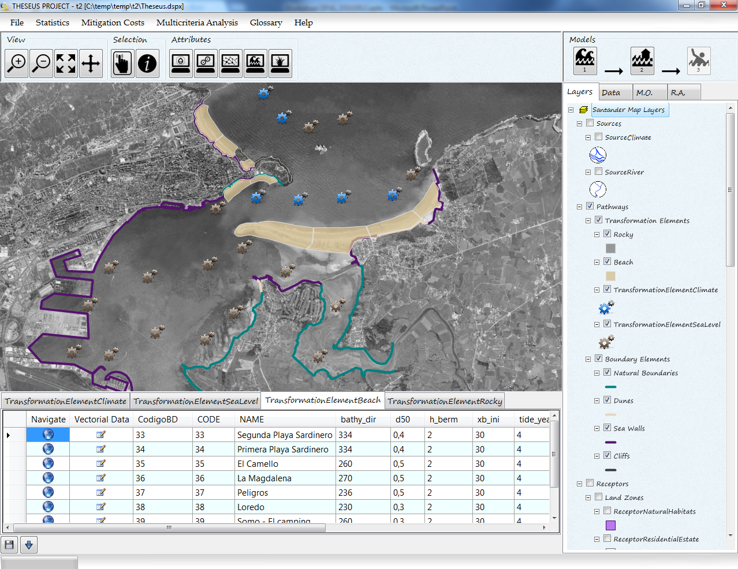

Slide 12
Case 1. The Macro Scale: e.g., Latin America and the Caribbean
Case 2. The Micro Scale: e.g., The city of Santander (SP)
Case 3. The Meso Scale: e.g., Gulf Coast

Slide 13



Hazard Sets Scenarios
CLIMADA
Coastal hazards
Storm generation
Atmospheric hazards
Hs
SS
W
Precip.
pFH
Wave attenuation model
(InVest Coastal Protection tool)
NOTES:
First order of complexity (1D)
Statistical simulation
Additional advances:
  SWAN-Veg
  Adcirc
  VOF-RANS runs
Coastal profile
pFH insh.
pFH
Ecosystems
protective services
pFH inshore
Impacts on assets
Damages, Events Losses Sets
Cost/Benefit of adaptation measures

Slide 14
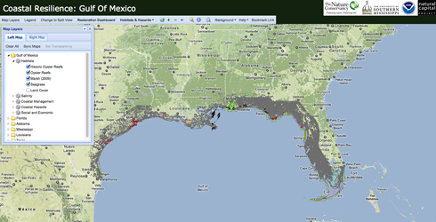
1. Databases
www.coastalresilience.org
www.unisys.com
www.nooa.com
….
Hazard data (hurricanes and LT trends)
Bathymetry & topography
Types of ecosystems, coastal defenses and coastal profiles
Socio-economic Vulnerability data (population, coastal assets, etc.)

Slide 15
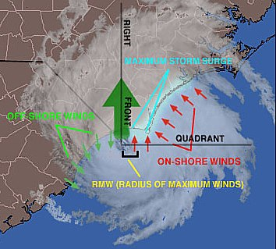
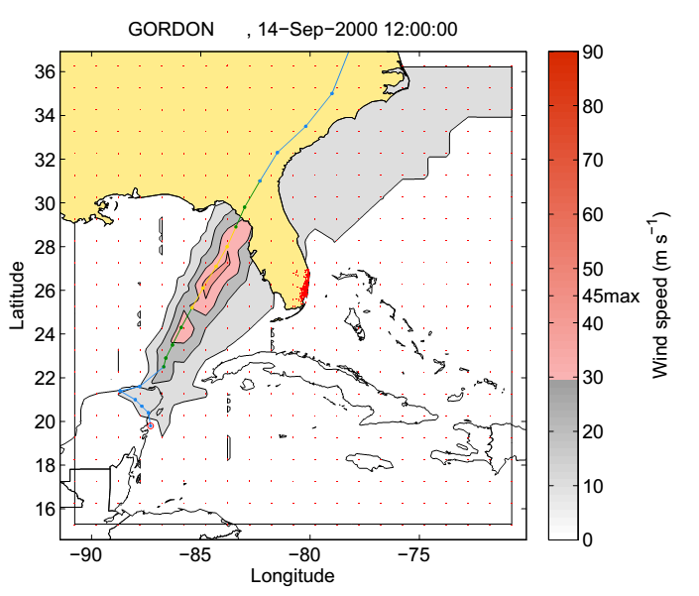
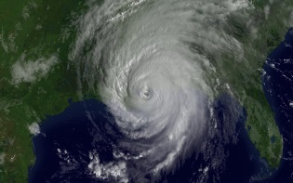
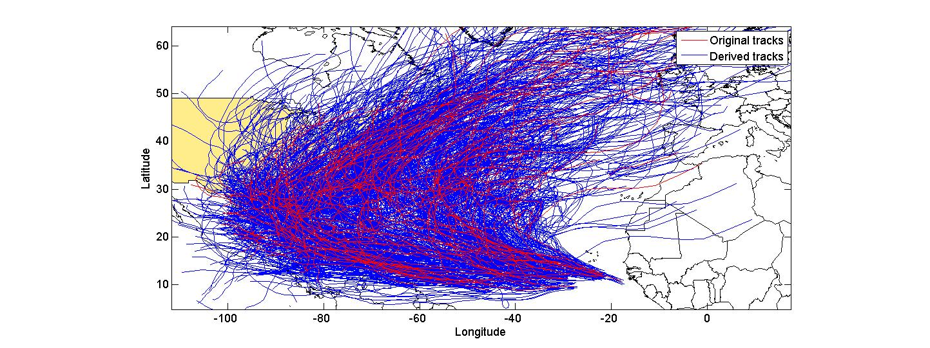
1. Databases
2. Generation of Hazard sets (Wind, precip., SS, Waves)

Slide 16
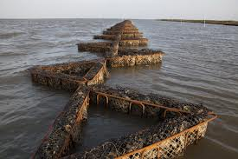
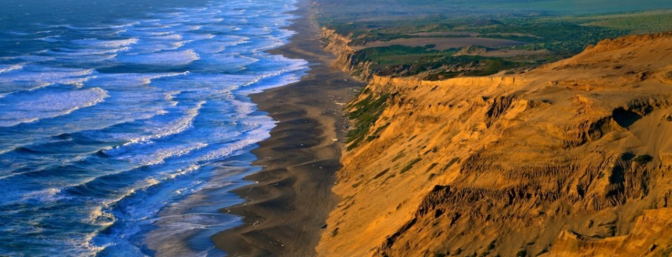
1. Databases
2. Generation of Hazard sets (Wind, precip., SS, Waves)
3. Coastal features and possible adaptation options (role of green/gray infrastructure)

Slide 17
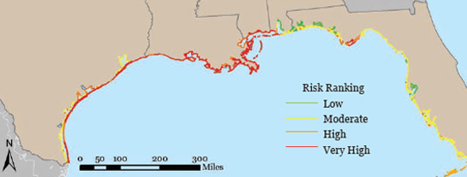
1. Databases
2. Generation of Hazard sets (Wind, precip., SS, Waves)
3. Coastal features and possible measures (role of green/gray infrastructure)
4. Evaluation of potential damages and overall risk
Comparison of each scenario:
  Current situation
  Economic growth scenario
  Scenarios with future changes in (i) hazards, (ii) ecosystems and/or (iii) measures adopted
e.g. USGS, CVI

Slide 18

Summary
Each scale presents different features (i.e. data) and requires different tools
Processes-integrated vs Processes-resolving tools
Overall, a similar approach = Risk Framework
By comparison of scenarios (risk together with the other terms):
  identify where and (possibly) what “solutions” to study further

Slide 19

Thank you
Borja G. Reguero gonzalezrb@unican.es
I.J. Losada
F.J. Méndez
M. Beck
C. Sheppard
Acknowledgements: ECLAC, OECC-SP Gob., NOAA, TNC, NatCap
Sources of pictures in the presentation: TNC, NOAA, USACE, USGS, Swiss Re, online press

Slide 20
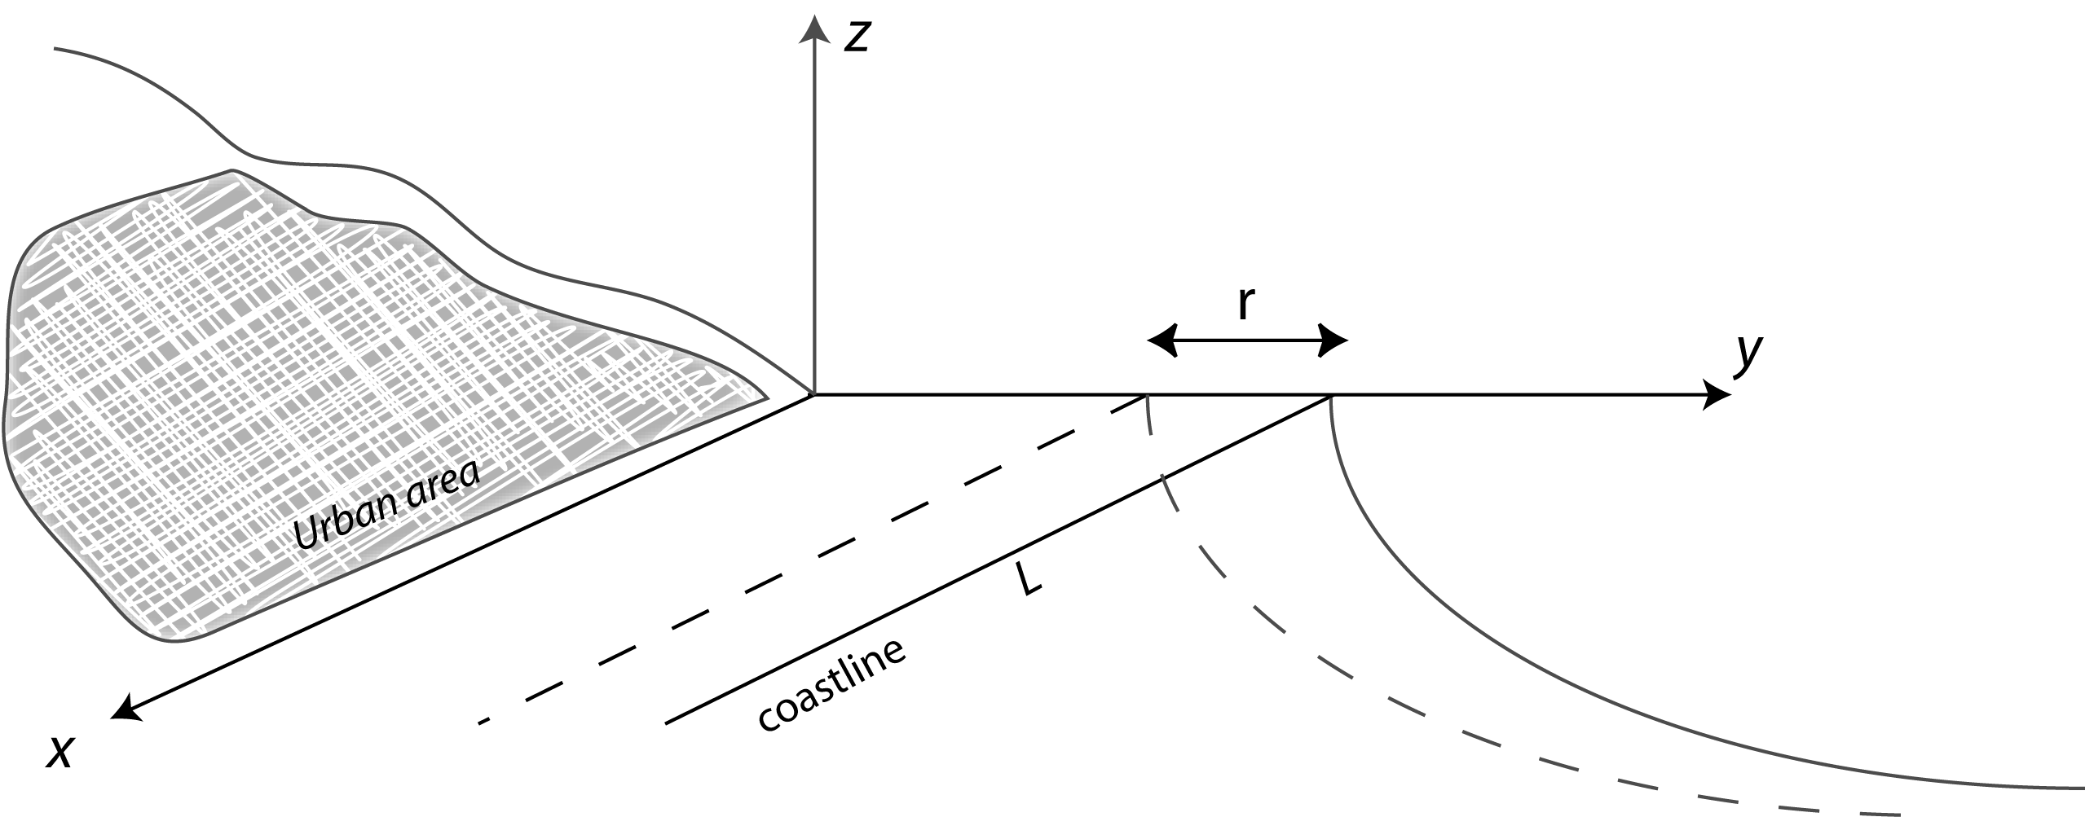
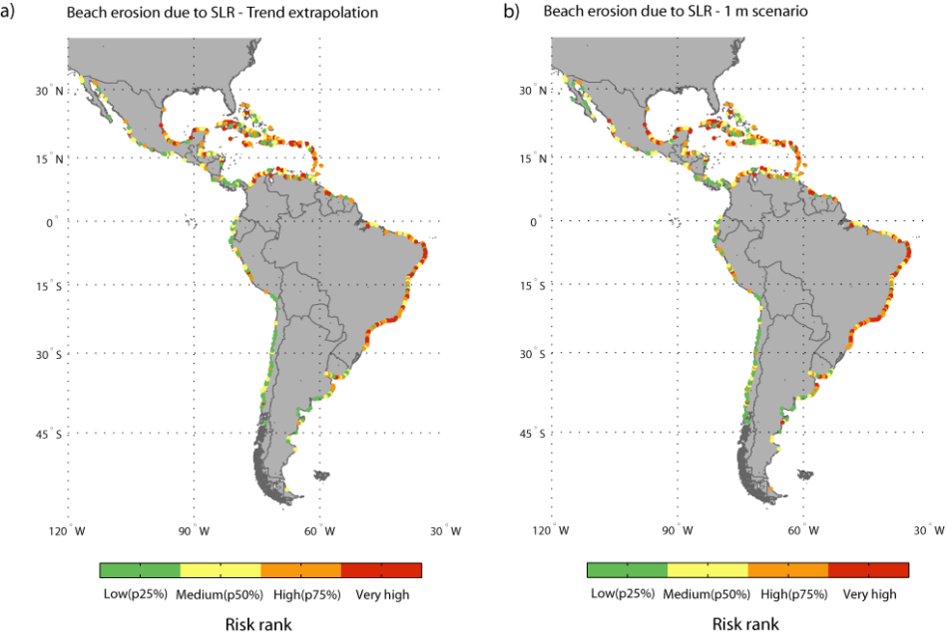
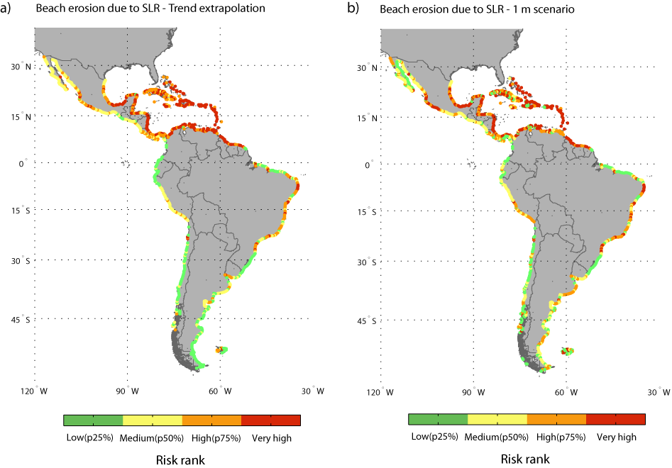
Example of risk integration 1:
Erosion Risk (Sandy Beaches)
2 functions:
Coastal Urban areas protection
Resource (Tourism)
Urban beaches as a natural protection
Beaches as a resource

Slide 21
Risk Assessment in a changing climate
V(z)
change vulnerability
change hazard
f(z)
f(R)
R

Slide 22
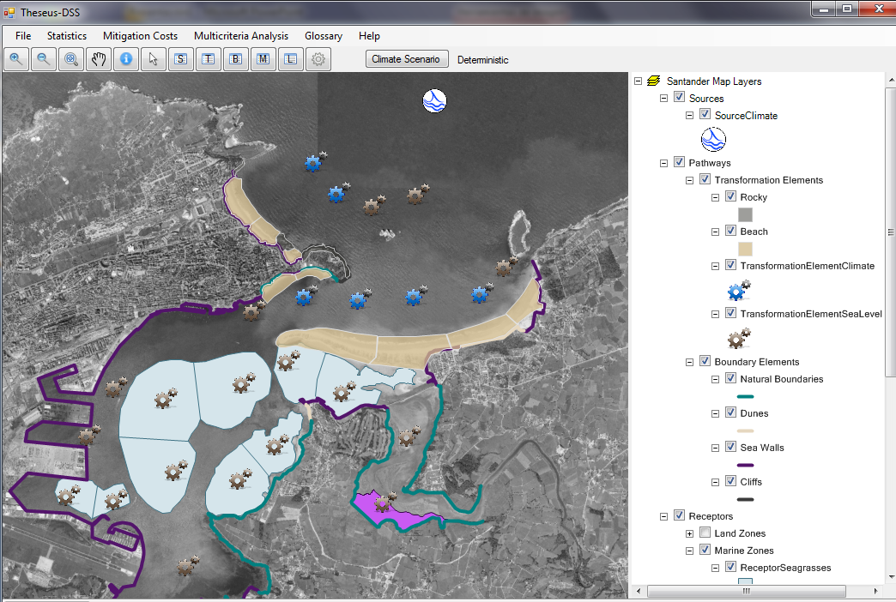
Sources
Pathways
Receptors & Consequences
INPUTS
FUNCTION
OUTPUTS
depth, population, patrimonial_value - inland_consequences- loss_life, edr
vel_x, vel_y, habitat_id - outland_consequences- evi
hs, tp, wave_dir, eta_ast, eta_met, bathy_dir,… - beach- xb, hs, q_long, v_long, dean_par,depth
hs, tp,wave_dir, eta, bathy_dir, h_ini, h_end - shoal- hs, wave_dir
hs, eta, hc, length - sea_wall- q
hs, tp, wave_dir, eta_ast, eta_met - offshore_to_coast - hs, tp, wave_dir, eta,depth, vel_x, vel_y
FLOODING MODEL

