Slide 1
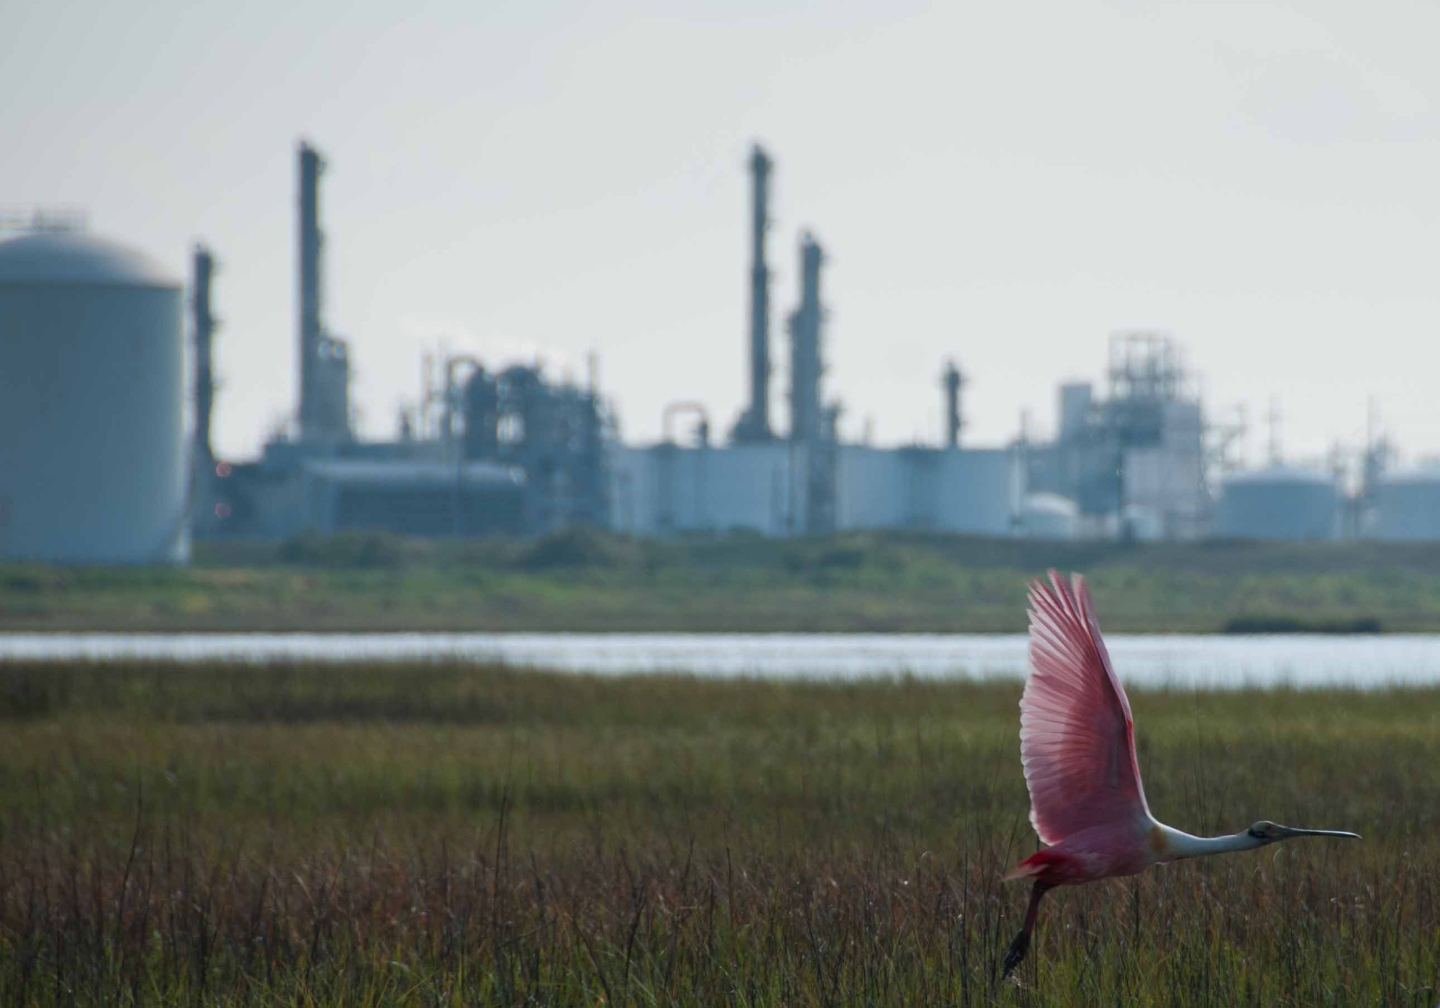
Jennifer Molnar
Enabling Businesses To Evaluate the Role of Habitats in Hurricane Risk Mitigation
Jennifer Molnar, Director of Science
Notes:
Walk through analysis done at a corporate property on the Gulf Coast –
Part of our 5-yr collaboration with Dow CC, corp accounting for value of nature

Slide 2
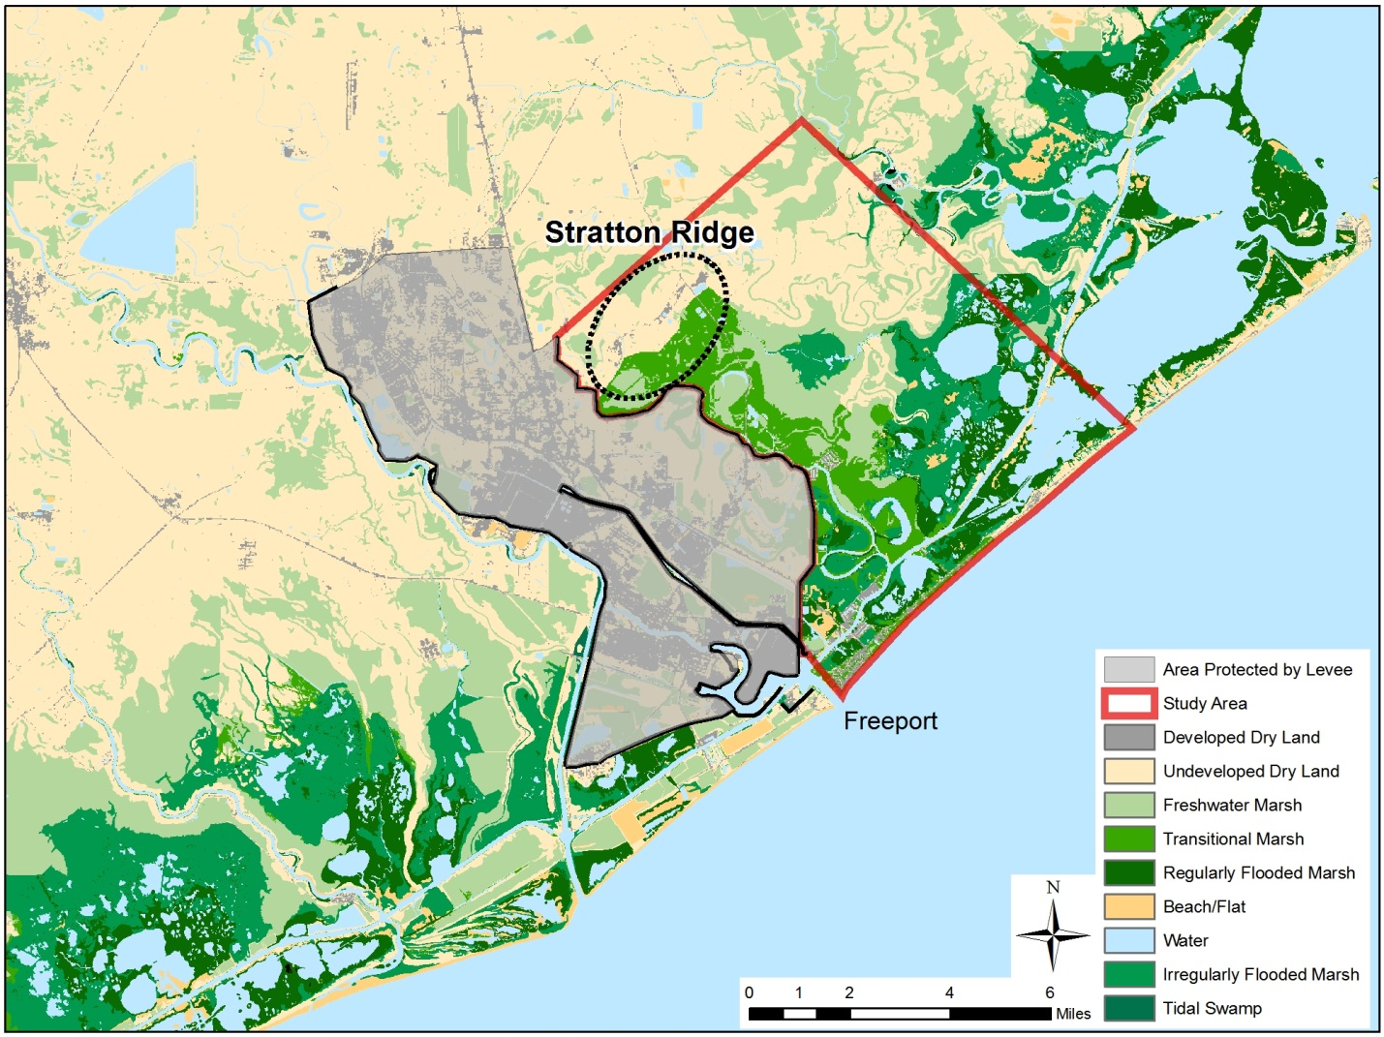
Case study: Dow Texas Operations, Freeport
Dow Texas Operations
Gulf of Mexico
Notes:
Dow’s plant – their largest in the world –
Most of site surrounded by levees, but - SR vulnerable, and working on designing levees
6 miles inland – not accounting for marshes

Slide 3
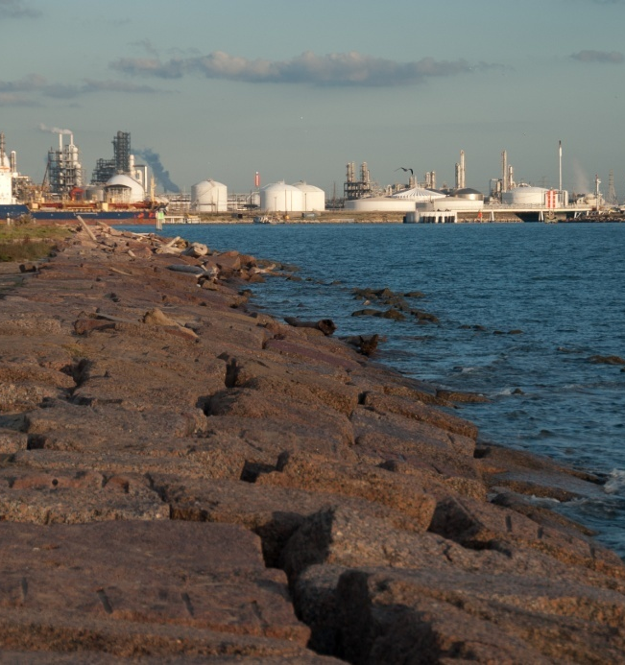
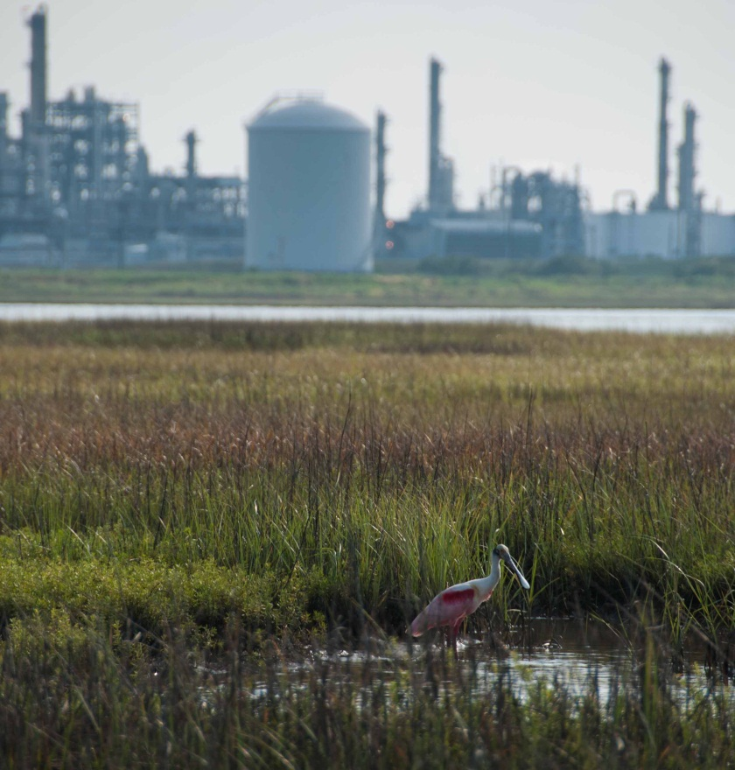
Engineered and natural defenses
Jennifer Molnar
Notes:
chance to inform a discrete infrastructure decision
Including the protective role of habitats and sea level rise in assessment of hazards at the Freeport site ---two key pieces of information previously not considered in industry-standard modeling
--- allows Dow to better inform their risk modeling process.

Slide 4
Valuation for Corporate Coastal Hazard Mitigation
Levees
Natural Hazard Mitigation
Economic Costs and Benefits to Business and Public
Habitat
Additional Benefits
(e.g. Recreation)
Biodiversity

Slide 5
Overview of Analysis
Model future land cover with sea level rise, development
Identify levee design for 100 yr storm
Analyze flood and damages from Cat 1-5 storms
Compare avoided damages
Assess other public and ecosystem benefits
Evaluate opportunities to enhance/protect values
Notes:
Scenarios – habitat, levee, both
NatCap!!!
Waves riding on top of surge---- conservative assumption that habitat does not affect surge
Advancements from previous modeling– habitat (realistic landcover), waves, sea level rise

Slide 6
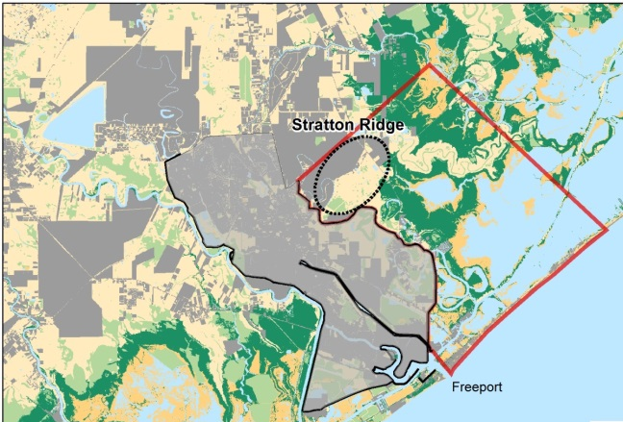
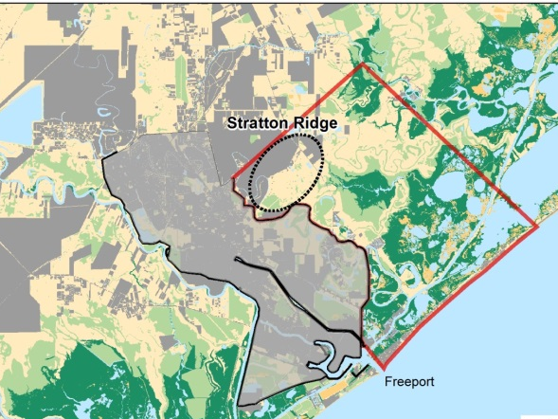
Sea Level Rise and Decreasing Marsh Habitat
9% decrease in marsh
35% decrease in marsh
Current
2050, 0.57 m sea level rise
2100, 1.29 m sea level rise
Notes:
SLAMM outputs predict that under a scenario of 1.3 m local sea level rise by 2100 the total land area in the Stratton Ridge study area will decrease by 23% by 2100, with the greatest losses occurring in the second half of the century
Inundation of marshes and conversion to bare mud flats is projected to decrease marsh area by 9% by 2050 and 35% by 2100

Slide 7
Future Loss of Marsh and Sea Level Rise Increases Risk in 2050
0.57m
Sea Level Rise
11% Higher Floods
9% Higher Levee Costs
Mitigating Effect of Habitat
1% Lower
Floods
1% Lower
Levee Costs
Notes:
Projected sea level rise and loss of marshes may increase risk from hurricanes in the future by increasing flood heights at Stratton Ridge. These trends suggest that levees designed for 100 yr storms under future conditions may need to be higher. Habitats have a limited mitigating effect on flood heights and levee costs because of their small and decreasing size. Current day habitats may mitigate flood heights by 3% but this mitigating ability is reduced to only 1% by 2050. The levee costs savings from this reduction of flood heights are insignificant in this planning context.
Details:
Based on flood and levee design analysis for a 100 year storm:
- We predict that a 3.81 m levee would be needed under a dry land scenario, an 11% increase in levee height over a current day design height.
Accounting for the effect of habitats only reduces the required levee height in 2050 to 3.77 m, a 1% reduction.
Note that under current day conditions, habitats may reduce flood heights by 3%.
Assuming that the levee is built for 2050 flood heights, the cost of the levee will be $4.6 million (9%) higher than the cost of a current day design.
Accounting for habitats in the design of a levee for 2050 will only offset costs by $0.5 million or 1%

Slide 8
Private and Public Benefits from Habitat

Slide 9
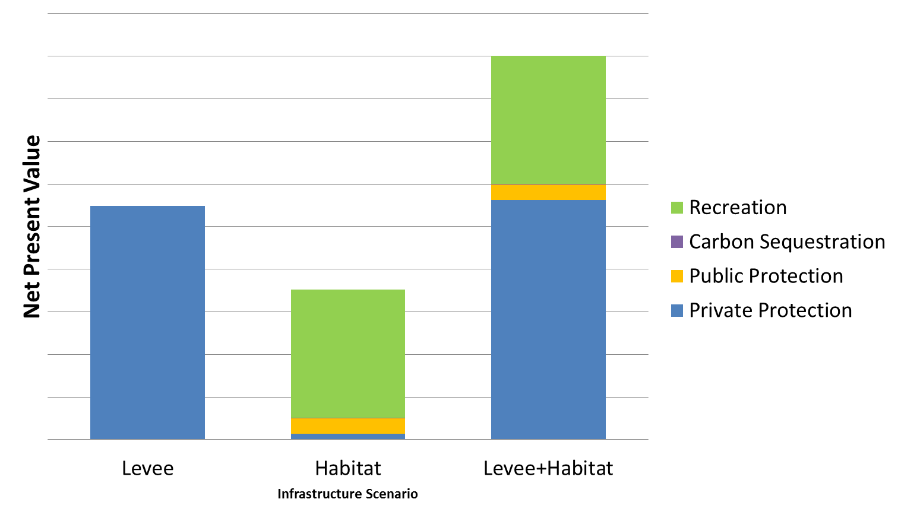
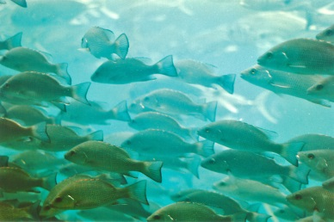
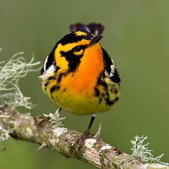
Private and Public Benefits from Habitat
Plus:
Habitat for 12 Fisheries
Habitat for >200 Species

Slide 10
Restoration May Maintain/Improve Benefits
Restored
Dry Lands
Notes:
Restoring marshes on all the undeveloped dry land habitats between Stratton Ridge and the coast (4,798 acres) would result in an 11 km extent of marsh (original extent: 5 km) and may provide additional storm protection benefits of almost $2 million.
Accounting for the opportunity cost of the land ($107/year/acre in grazing revenue) and restoration costs ranging from $12,800 to $50,900 per acre, restoration would not make business sense.
Restoration may be attractive if Dow could finance restoration through the establishment of a wetland mitigation bank or through partnerships with other parties that would receive benefits from the marshes.

Slide 11
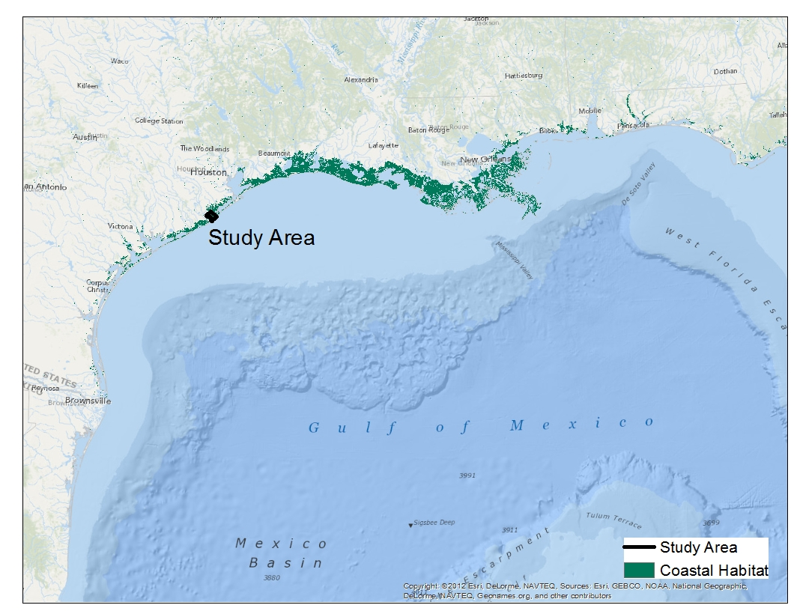
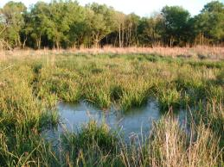
Other Potential Opportunities for Coastal Protection
c
Notes:
By comparing natural and built infrastructure scenarios together for Dow’s Stratton Ridge facility, we demonstrated the potential habitats have to provide protection from storms and reduce levee costs, as well as generate benefits for the public and support biodiversity. The magnitude of protection provided by habitats at Freeport did not warrant changes in Dow’s levee design, but the approach used here may help uncover opportunities for storm protection at other sites with larger natural areas. For example, measurements and modeling studies suggest that 30-50 km of marsh may reduce storm surge by 1 m. The area in front of Freeport was only 5 km of marsh but larger marshes in other area of the Gulf of Mexico may have greater storm protection potential.
Evidence from Hurricane Rita
Surge Attenuation
1 m per 30-50 km of additional marsh
(Wamsley et al. 2010 )

Slide 12
The Value of Information for Risk Management
Science
Business methods
Inform Conservation/ Business Priorities
Jennifer Molnar
Notes:
Value of new information – habitat and SLR
Science: Link ecological change to business value
Business method: Ability to value missing assets
Inform Conservation/ Business Priorities: Where / when do marshes have significant protective values? What are additional
Advanced science– link eco change to multiple economic values for a specific decision
Methodology for valuing missing assets
Quantified values for marshes at Freeport
Identified when protective values may be low
New information for risk mitigation

Slide 13
Acknowledgments
TNC-Sustainability Science: Sheila Walsh (co-lead), Tim Boucher, Jon Fisher, Anthony Rogers, Alex Maas, Jen Molnar
Dow: Doug Whipple (co-lead), Daniel Ramirez, John DiMuro, Judy Gunderson
TNC-TX: Michael Thompson, Jorge Brenner
Natural Capital Project: Greg Guannel, Rob Griffin, Joe Faries, Joey Bernhardt, Greg Verutes, Spencer Wood, Jess Silver, Jodie Toft, Anne Guerry
TNC-Global Marine: Mike Beck, Chris Shepard
Warren Pinnacle Consulting: Jonathon Clough, Marco Propato, Amy Polaczyk
AIR: Akshay Gupta, Andrew Kao
Funding: Dow Chemical Company Foundation

