Slide 1
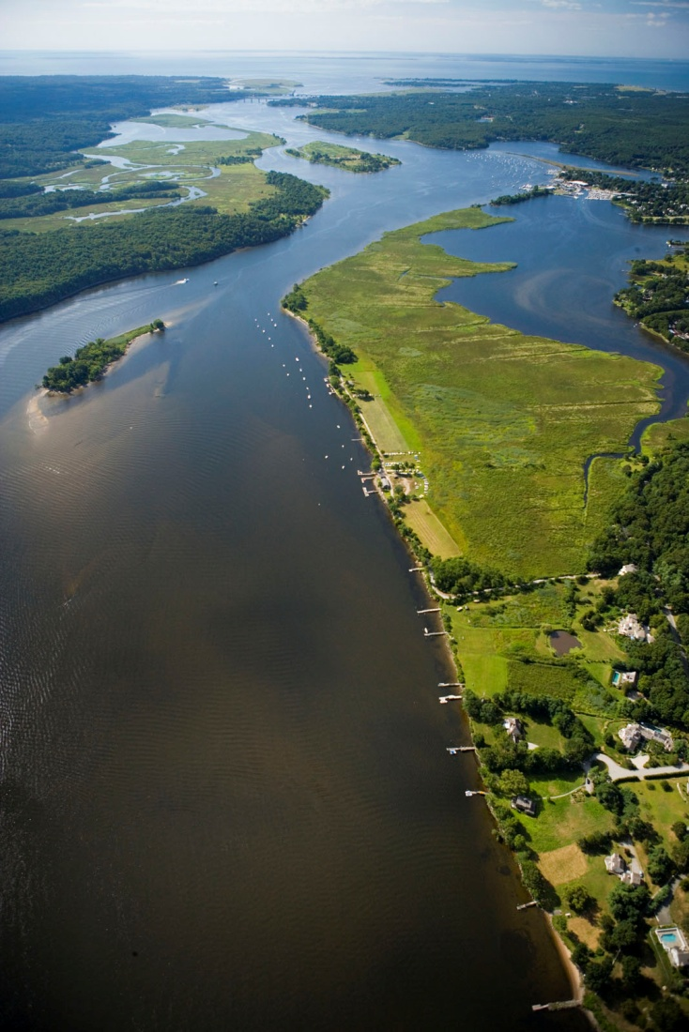
Floodplains by Design:
natural infrastructure
for people and for nature
Kris Johnson, PhD
5/29/2013

Slide 2
Annual flood damages in U.S. 1903 – 2011
Source: NOAA

Slide 3
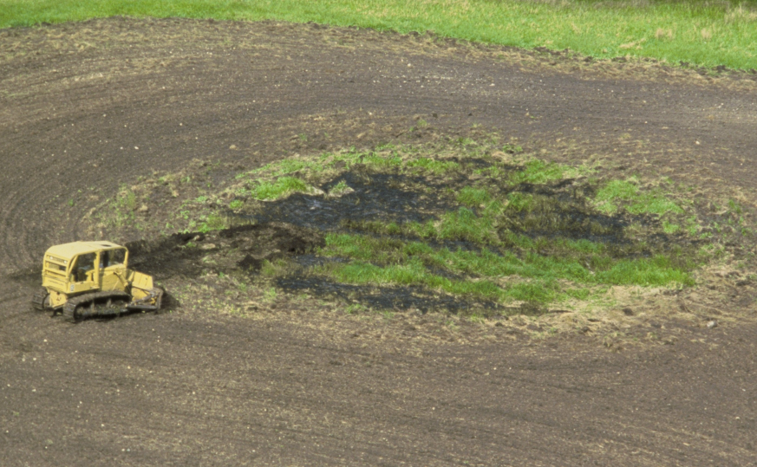
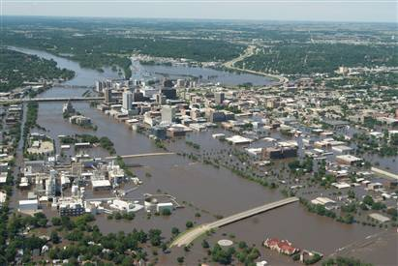
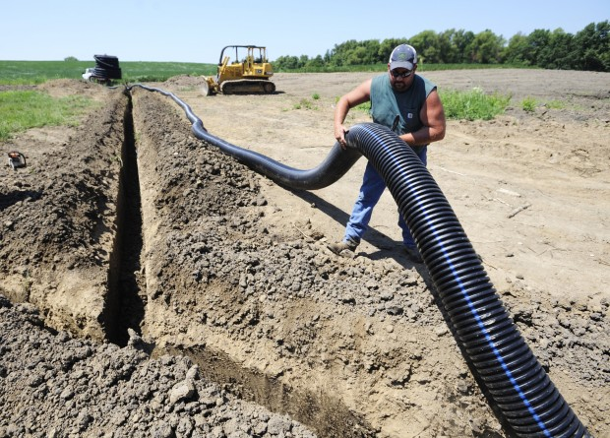
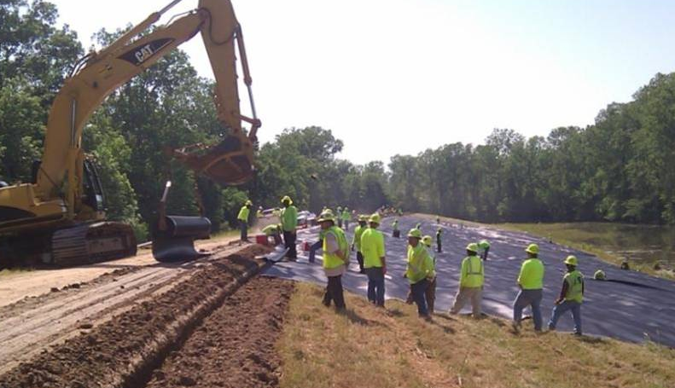
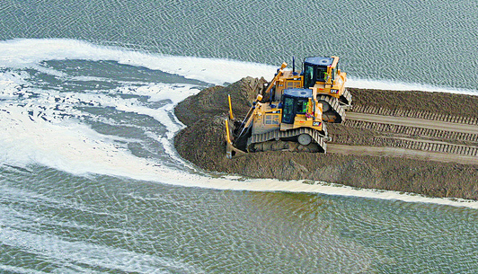

Slide 4
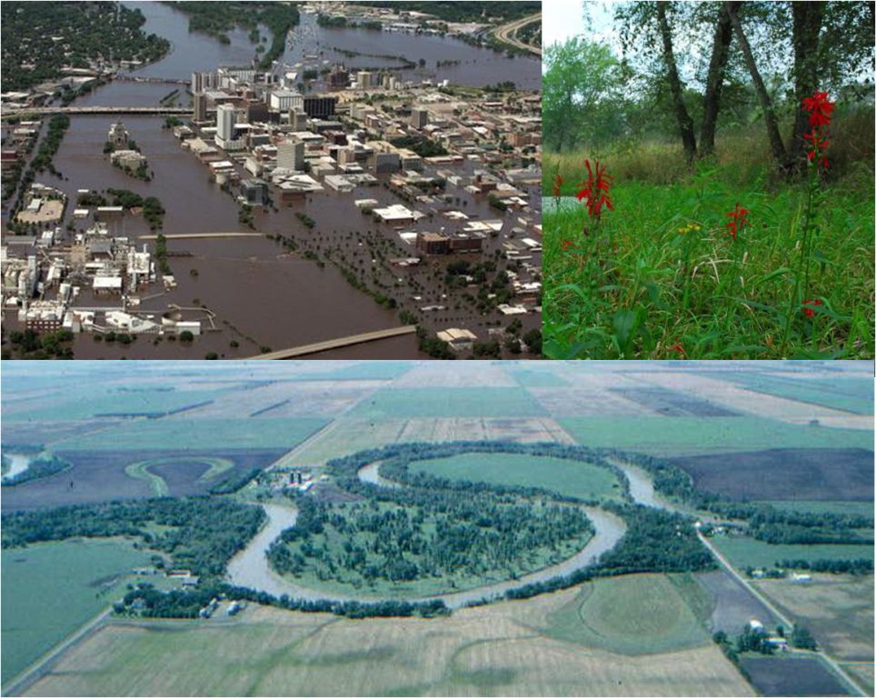
Floodplains by Design Meeting the Needs of People and Nature
Advancing floodplain protection and management

Slide 5
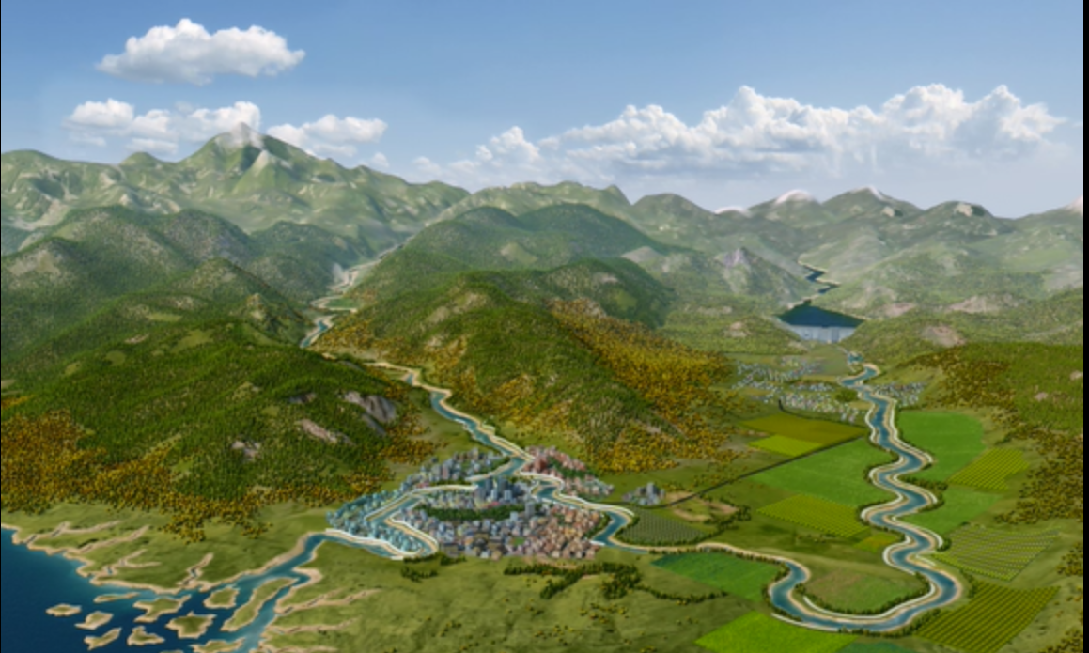

Slide 7
Notes:
Status quo flood management (grey inf)

Slide 8
Notes:
Big flood overcoming grey infrastructure

Slide 9
Notes:
Add setbacks, floodway

Slide 10
Notes:
Moderate flood, some portions of green infrastructure not inundated

Slide 11
Notes:
Big flood, everything inundated

Slide 12
Floodplain Mosaic
Frequently flooded; natural vegetation and ecosystem services
Moderate flood frequency: flood-compatible
agriculture
Rarely flooded: agriculture with compensation mechanisms
Managed wetlands to provide benefits from frequent inundation and to improve water quality

Slide 13
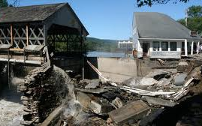
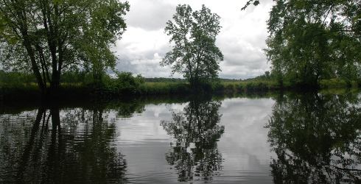
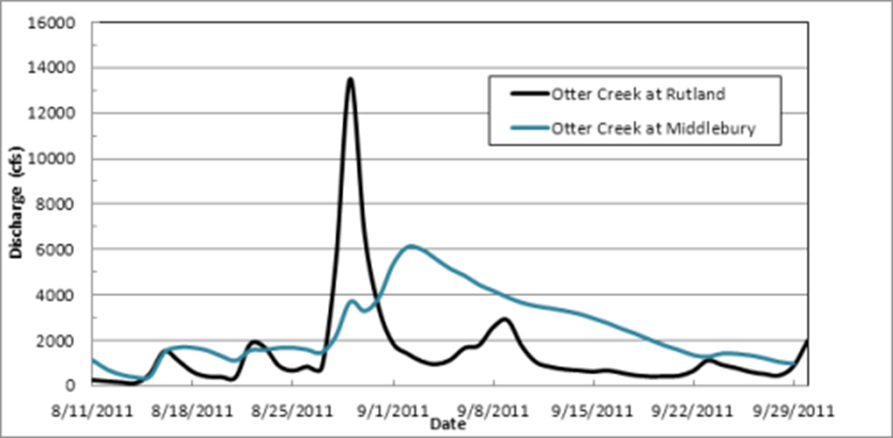
Otter Creek, Vermont
Notes:
At the height of Irene, Otter Creek flooded Rutland with almost 14,000 cubic feet per second (CFS) of water
on Aug 28, which is the highest flow ever recorded for this location, and is perhaps comparable to the flood of 1927 (which pre
-dates river flow data collection on Otter Creek). Much was heard in the news of flooding along Otter Creek in Rutland during Irene, but what about downstream of Rutland in Middlebury? Where did all that water go? Remarkably, Otter Creek in Middlebury, over 30 miles downstream of Rutland, peaked at only 6,000 CFS on Sept 3, and we heard very little news of flooding or damage in the Middlebury area. The answer to what happened to all that water lies between Rutland and Middlebury, in the Otter Creek swamp complex. The Otter Creek floodplain between Rutland and Middlebury is broad and flat, and features an extensive
complex of wetlands and swamps. Irene’s floodwaters in Otter Creek spilled over into the Otter Creek swamp complex, where it filled the broad, low-lying Otter Creek floodplain with water. Only gradually did this water flow back out of the swamp past Middlebury, resulting in a diminished peak flow compared to Rutland.

Slide 14
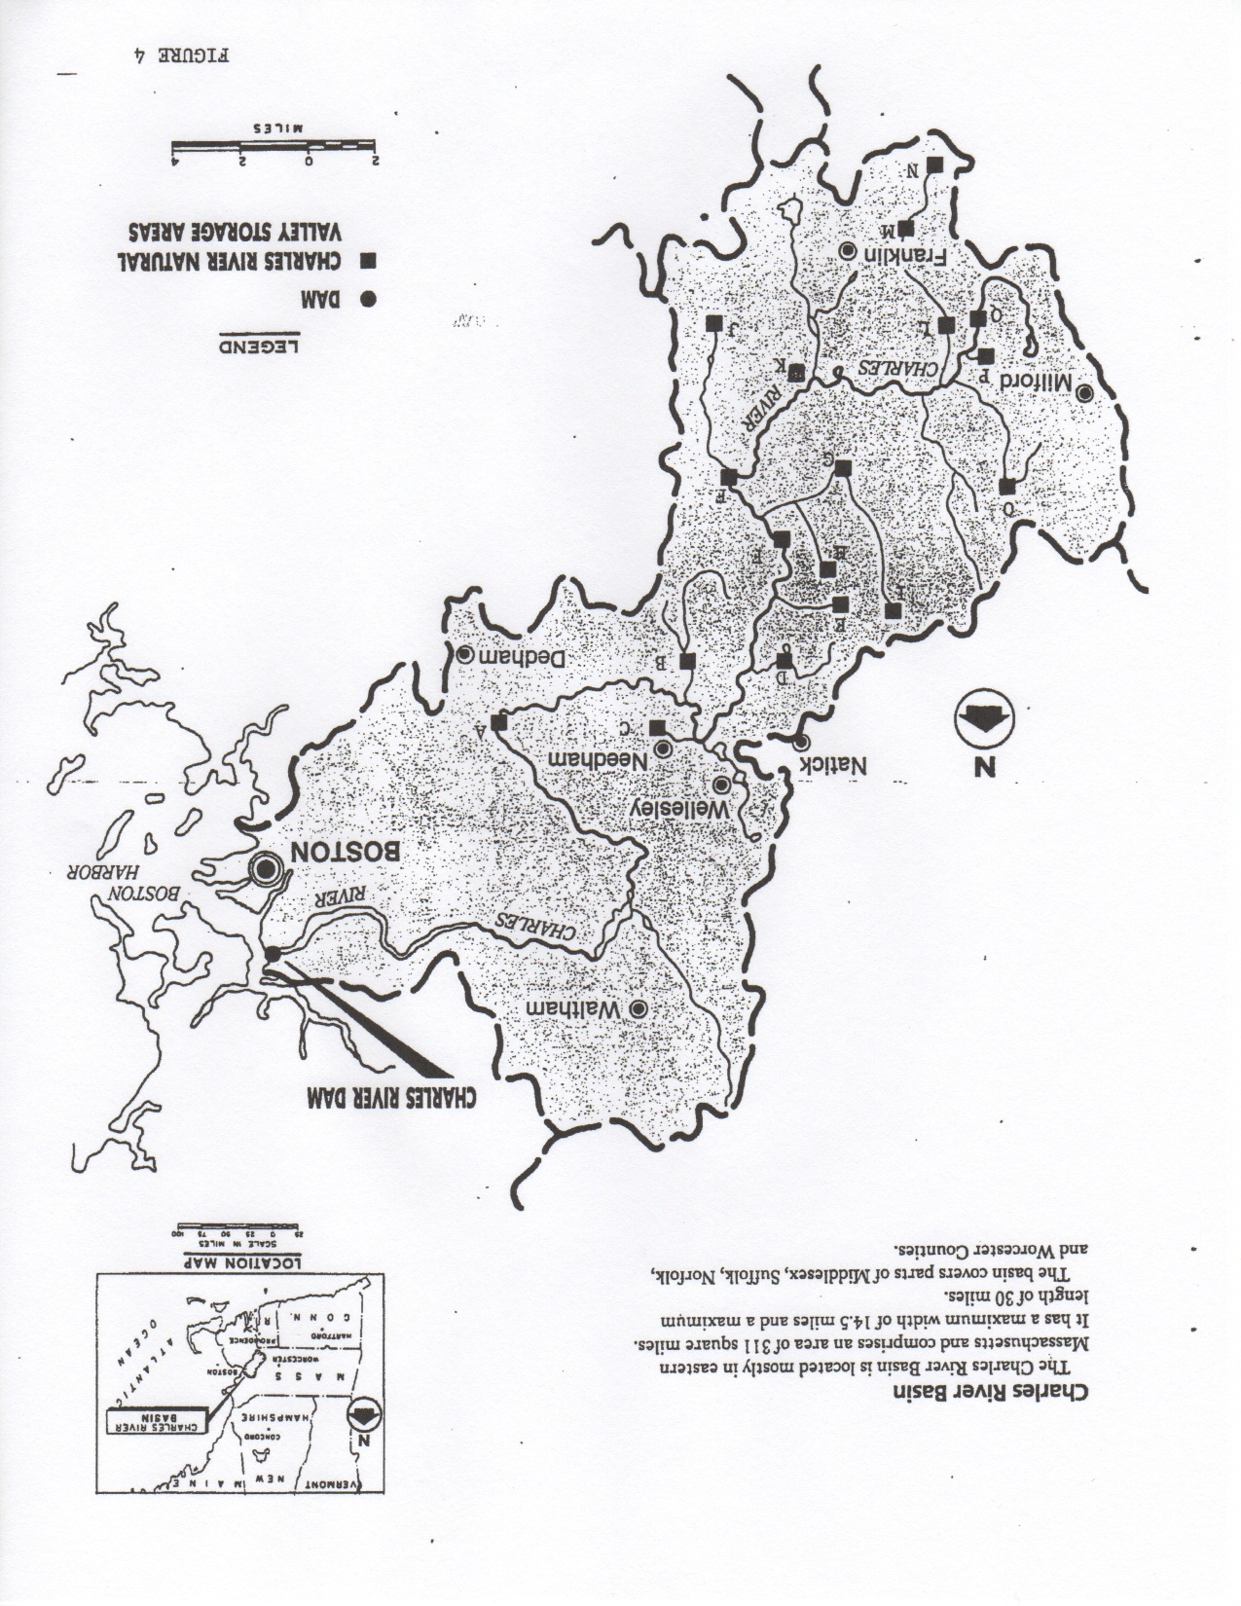
Charles River, Massachusetts

Slide 15
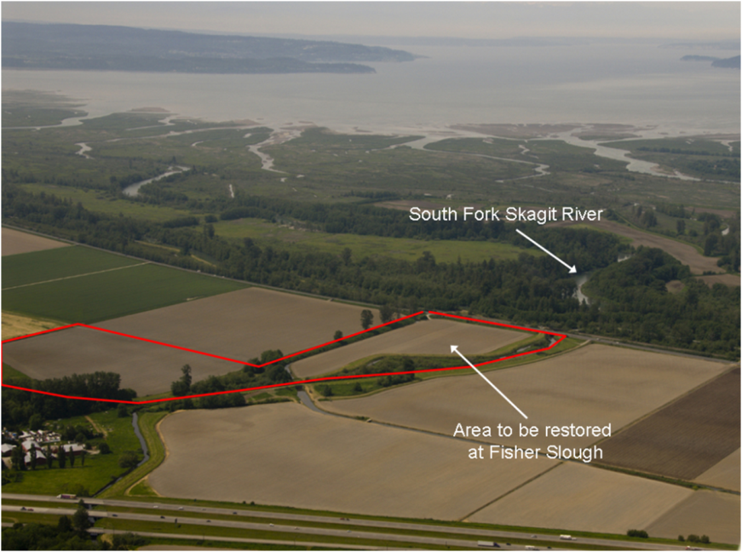
Fisher Slough, Puget Sound

Slide 16
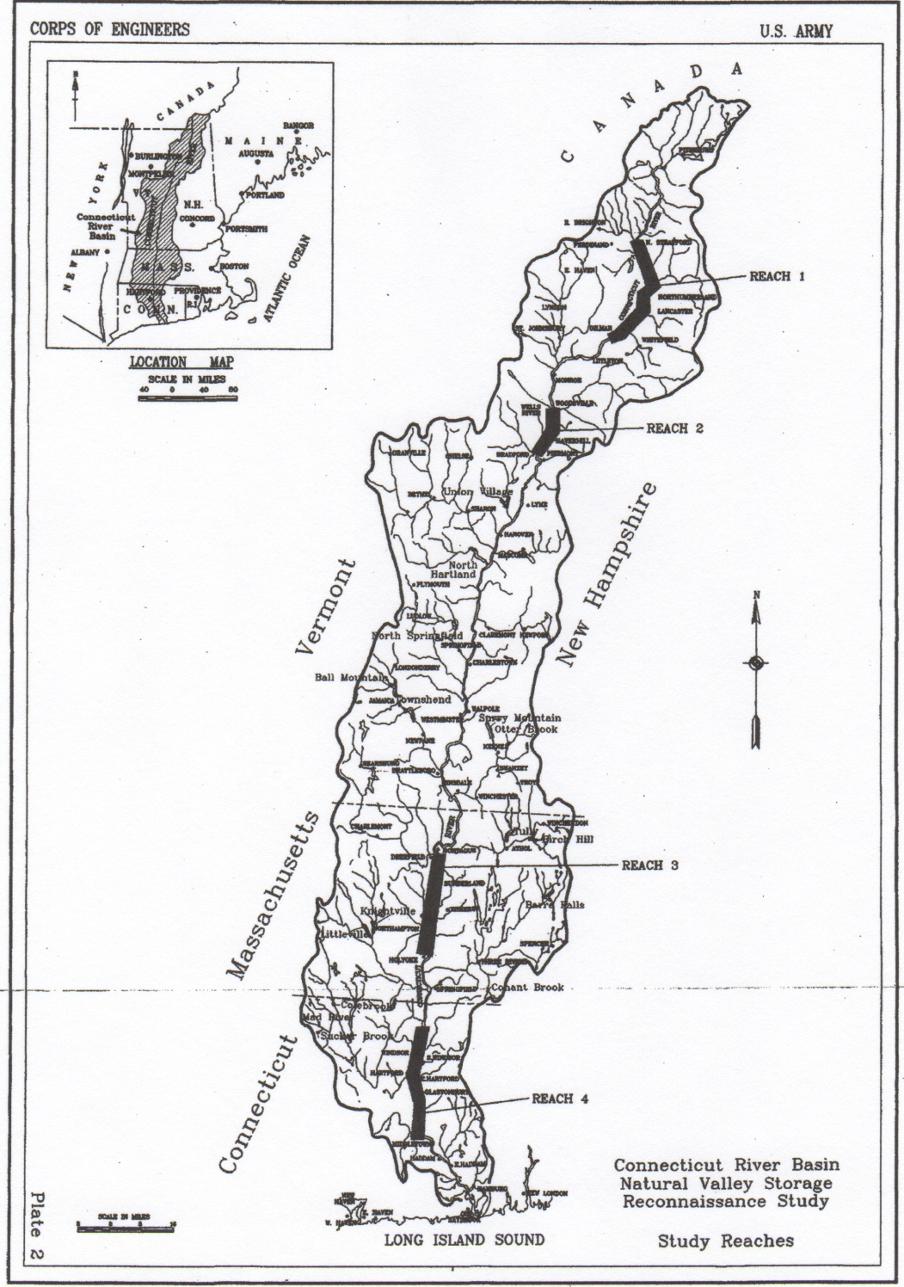
Connecticut River Basin

Slide 17
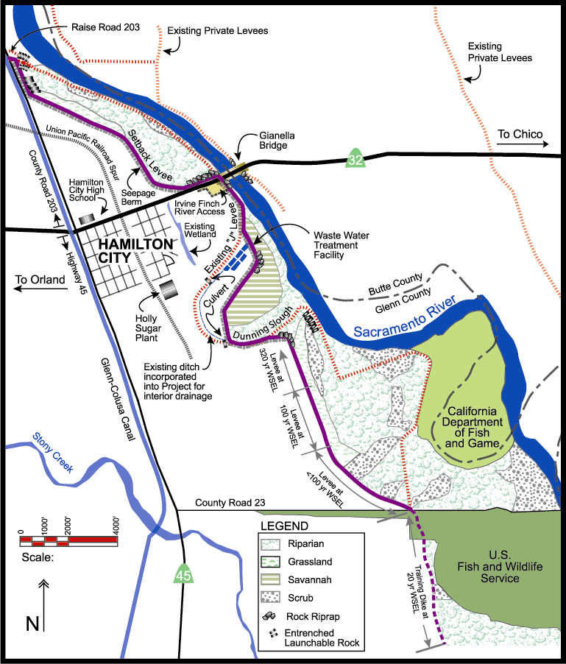
Notes:
A failing levee prompted USACE studies about rebuilding and redesigning the levee BUT the studies didn’t result in a positive CBA.
Then a study of a set back levee that included evaluation of public use and recreation benefits came out with positive CBA

Slide 18
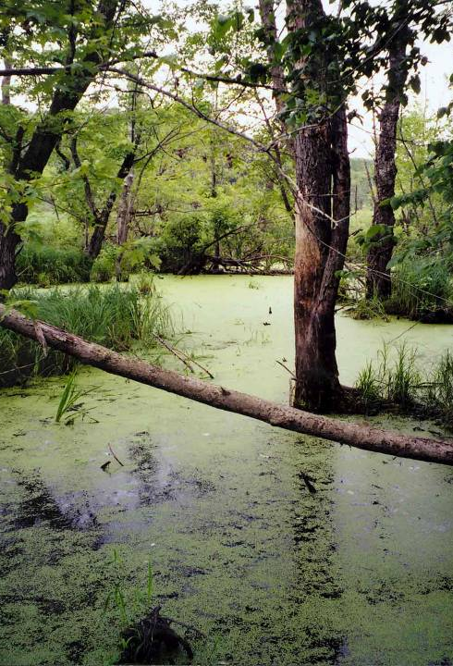
QUESTIONS?
kjohnson@tnc.org

Slide 19
The value of connected floodplains
Reared in
river habitat
Reared in
floodplain habitat

Slide 20
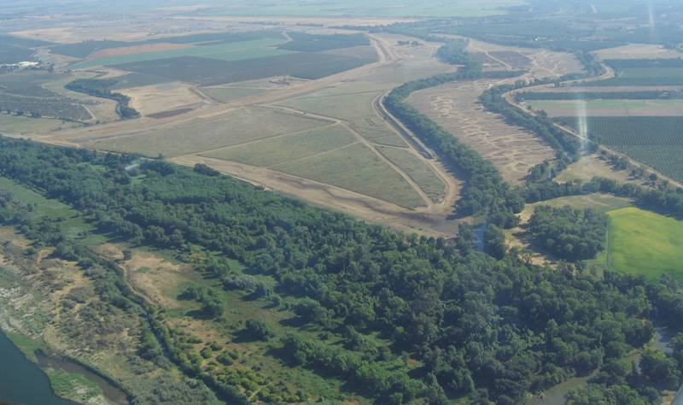
Remaining south levee
New setback levee
Removed north
levee
Wetland feature to increase
seasonal fish habitat value
Removed Feather River levee
Bear River
N
Feather River

Slide 21
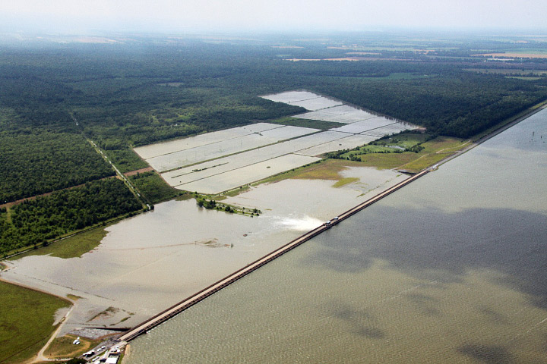
Notes:
Morganza Floodway in Mississippi River and Tributaries Project

Slide 22
Ecologically functional floodplains
Connectivity between river and floodplain
Variable hydrology, including a range of high flows
Sufficient geographic scale

Slide 23
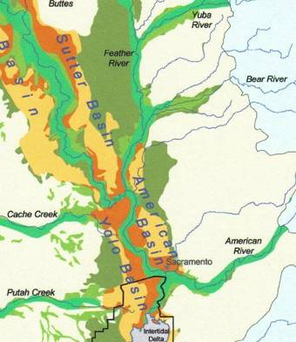
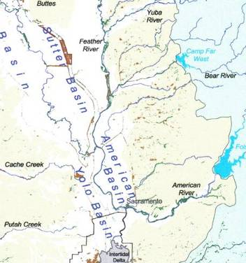
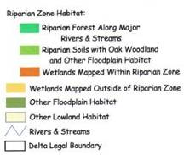
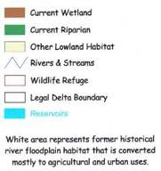
Loss of floodplain habitat in the Sacramento Valley
Historic
Current
The Bay Institute 1998
The Bay Institute 1998

