Slide 1
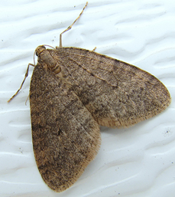
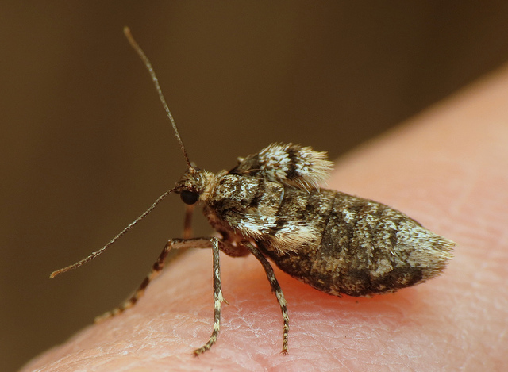
Winter Moth
Identifying Characteristics:
Females have tiny “vestigial” wings and may be found clinging to tree trunks, buildings, fences, etc.
Males are grayish-brown and have 1” wingspan
Male moths fly in November and December, and are attracted to light
Winter Moths may be confused with:
Bruce spanworm moth, a related native species that can hybridize with winter moth
Fall cankerworm is a native pest that also flies in fall and winter and has flightless females
Male
Female

Slide 2
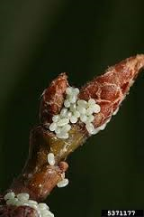
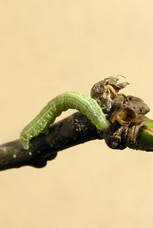
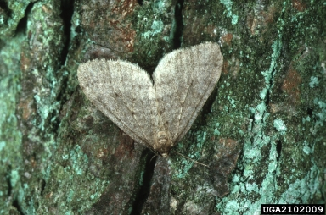
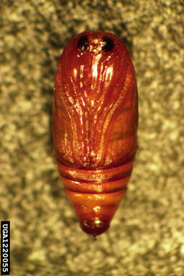
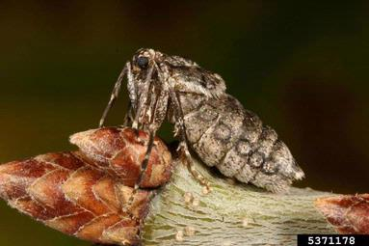
Winter Moth Life Cycle
Egg
Larva
Pupa
Male
Female

Slide 3
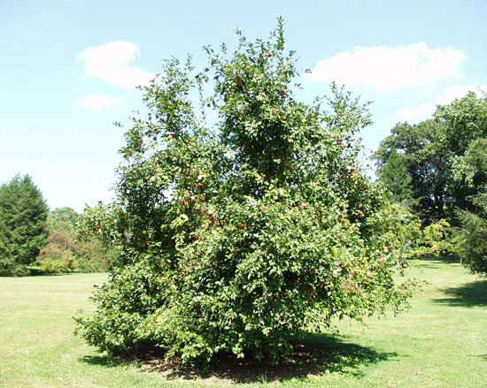
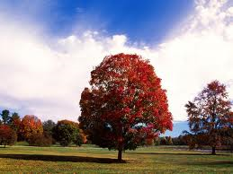
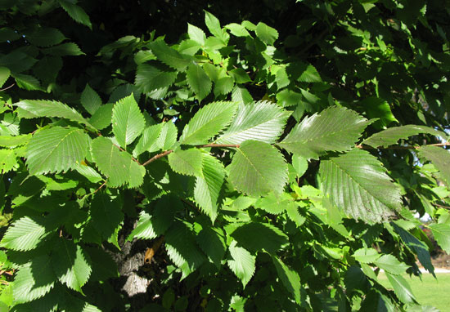
Winter Moth Common Host Trees
Callaway Crabapple
Oak
Maple
Apple
Elm
Ash
Basswood
Hop
Hornbeam
Fringetree
Crabapple
Cherry
Blueberry
Red Maple
American Elm
Notes:
Targets over 30 plant genera

Slide 4
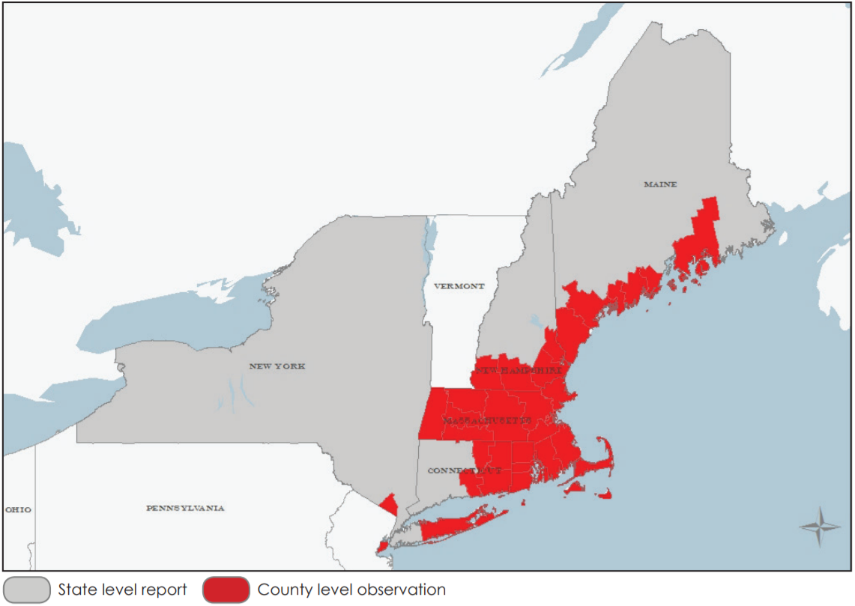
Winter Moth Map – Range of Winter Moth
American Elm

Slide 5
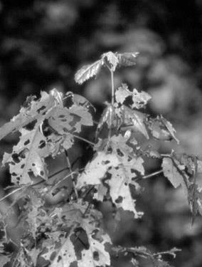
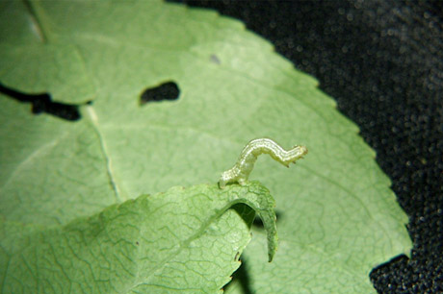
Winter Moth What to Look For
2
Significant tree defoliation and destruction of flower buds in early spring
Skeletonizing of leaves in severe infestations
1

Slide 6
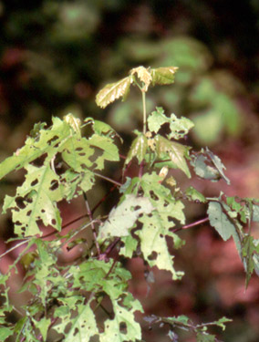
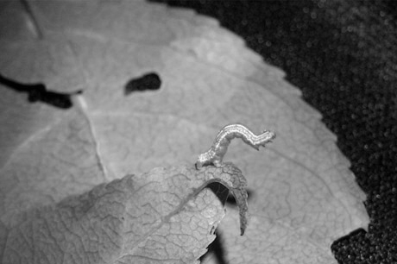
Winter Moth What to Look For
2
Significant tree defoliation and destruction of flower buds in early spring
Skeletonizing of leaves in severe infestations
1

Slide 7
Winter Moth What to Look For (cont.)
SPRING:
Green inchworm-type caterpillars with white stripes on the sides;
Severely damaged leaf buds; Dried and curled up while still on the tree
WINTER:
Adult males in flight or gathering at lights;
Mating pairs of moths on tree trunks, building foundations, fences, etc.
YEAR-ROUND: Frass; Damaged Leaves

Slide 8
Winter Moth Additional Resources
Bugwood Wiki
http://wiki.bugwood.org/Operophtera_brumata
Bugwood: Forest Pests of North America
http://forestpests.org/vd/8671.html
EDDMaps: Reporting App for Smartphones
http://www.eddmaps.org/

