Slide 1

Conservation Coaches and the Global Conservation Agenda
PJ Stephenson
WWF International
CC NET Coaches Rally,
16 November 2010, Santa Cruz, USA

Slide 2
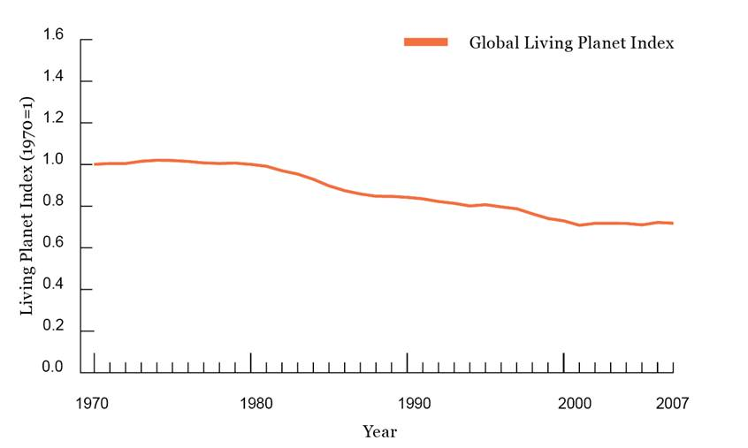
Living Planet Report 2010
Global Trends
Global Living Planet Index (-30%)
Source: Zoological Society of London
Notes:
Tracks more than 8,000 vertebrate populations of 2,544 species; Vertebrates down 30% in less than 40 years. 60% decline in tropics

Slide 3
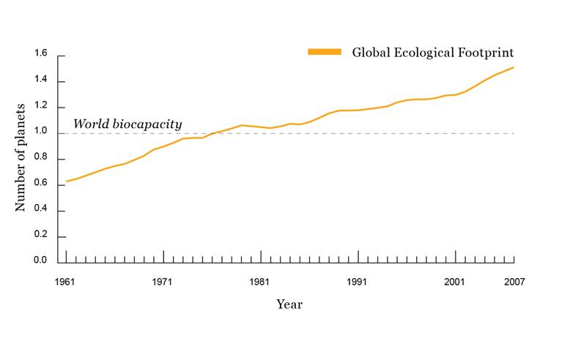
Living Planet Report 2010
Global Trends
Global Ecological Footprint
Source: Global Footprint Network
Notes:
Demand on the biosphere has more than doubled since 1961, largely due to carbon footprint which has increased 11 fold. Even using modest predictions, expect to need 2 planets by 2030

Slide 4
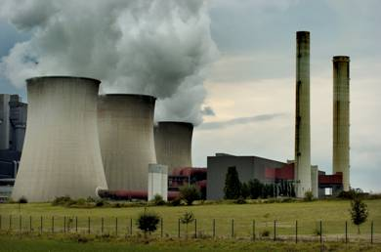
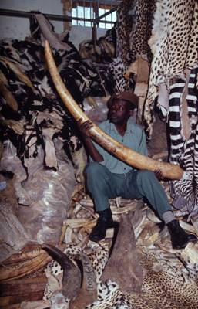
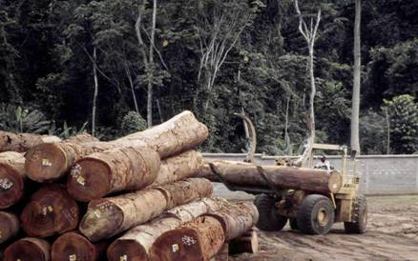
© Andrew Kerr / WWF-Canon
© Michel Gunther / WWF-Canon
© N.C. Turner / WWF-Canon
Notes:
Traditional threats continue: over-exploitation of species, habitat loss, climate change and pollution from emissions, invasive species

Slide 5
Reversing the trends: tackling the drivers
  Climate change
  Socio-political drivers
    poverty; subsistence
    governance; land tenure
    attitudes to wildlife and human-wildlife conflict
    legal and policy frameworks
  Economic drivers (consumption, production, markets & trade)
    private sector standards
    public and private sector finance

Slide 6
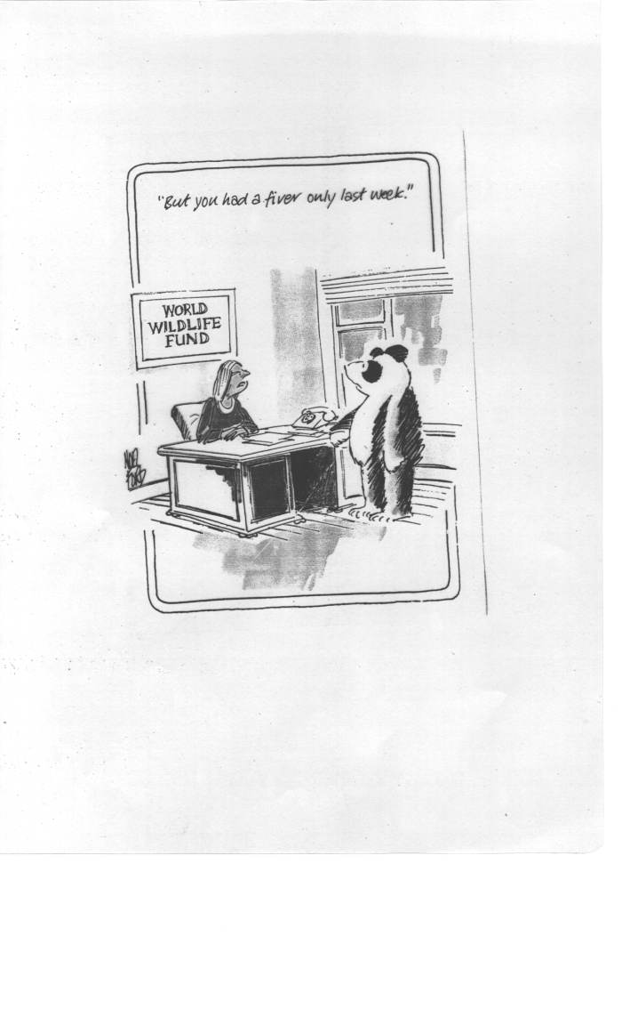
Notes:
How do we choose the most important species? There are so many – more than 1.4 million recognized 17,291 species - more than one third of those assessed - are in danger of extinction according to IUCN Red List (21% of mammals, 28% of reptiles, 70% plants). Many are under threat even if their habitat is conserved.

Slide 7
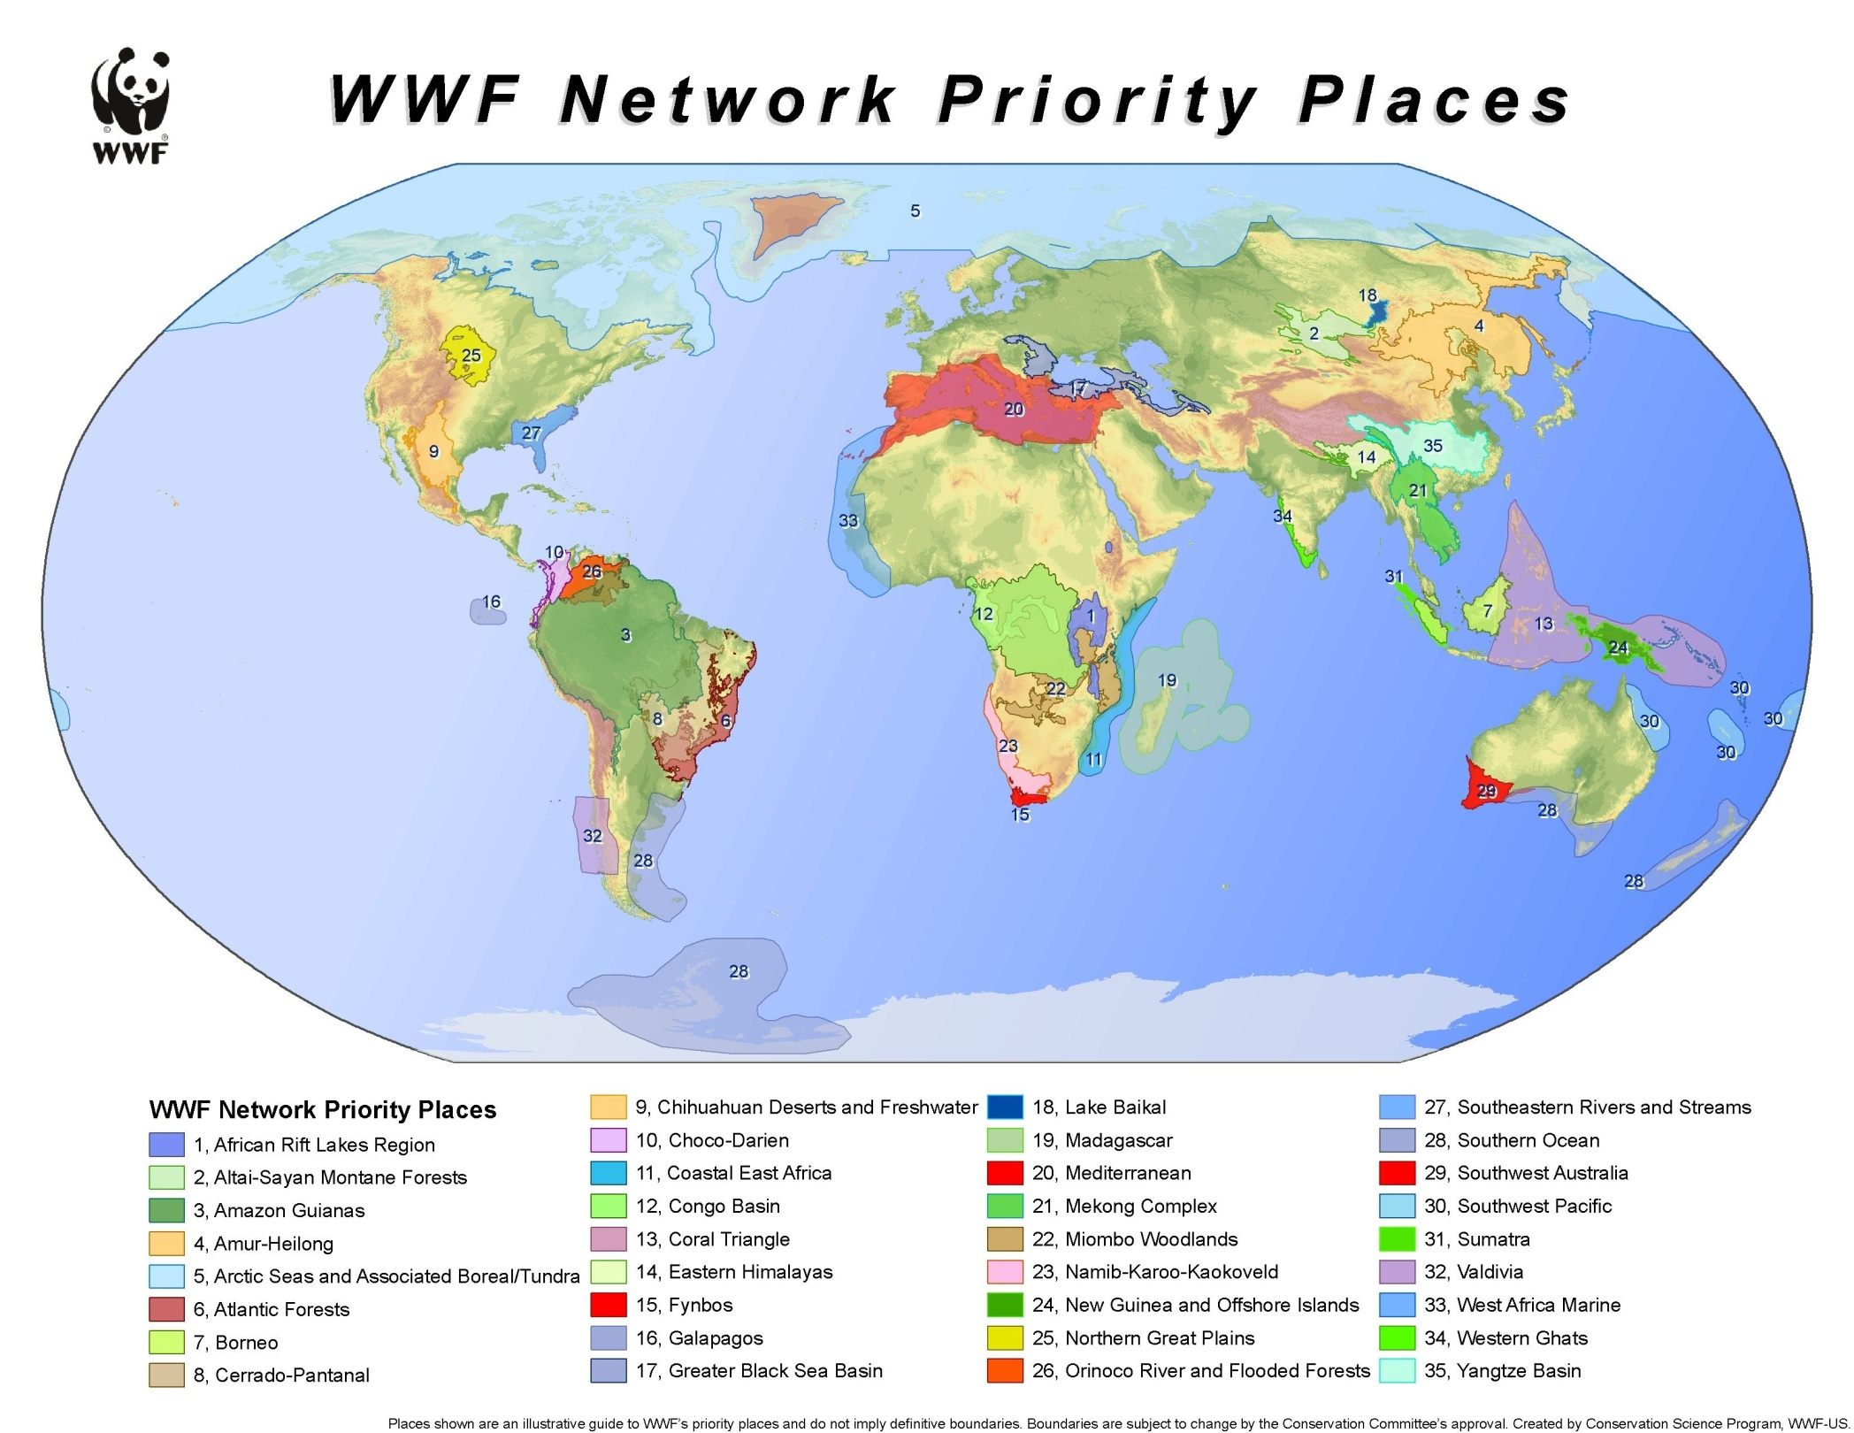
Notes:
Explain logic of choosing biogeographically representative selection from each MHT
35 places, 107 ecoregions
Implementation: some later, some by one office, some by whole network (NI concept?)

Slide 8
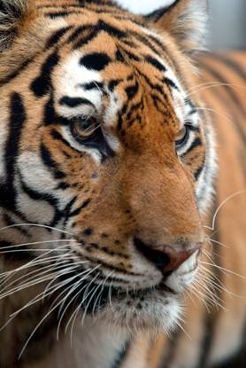
Global Priority Species
Flagship Species
African elephant
African great apes
African rhinos
Asian big cats
Asian elephant
Asian rhinos
Giant panda
Kangaroos
Marine cetaceans
Marine turtles
Orangutans
Polar bear
River dolphins
Footprint-impacted species (23): commercial timber species (e.g. mahogany, African teak), industrial fisheries species (e.g. cod, tuna), and other species threatened by over-exploitation (e.g. corals, reef sharks, freshwater turtles)
© WWF-Canon / Vladimir FILONOV
Notes:
Categorized top 36 into two categories.
We will use SAPs to determine objectives and indicators for flagships. Footprint spp mostly delivered through policy work (especially CITES)

Slide 9
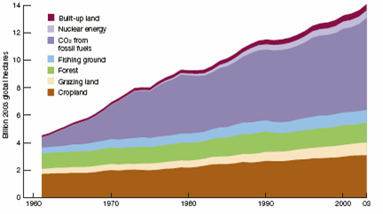
Sectors driving the Ecological Footprint
3%
Key sectors/
sub-sectors
Energy
Transport
4%
48%
Fisheries
7%
10%
Pulp & paper
Timber
6%
Livestock
Palm oil
Soy
Cotton etc
22%
Source: WWF Living Planet Report 2006
Notes:
Can break the footprint down into components – gives us an idea what we have to tackle. As you can see carbon and agricultural production are key, as is forestry and fisheries impacts.

Slide 10
WWF’s 2020 Footprint Goal
By 2020, humanity’s global footprint falls below its 2000 level and continues its downward trend, specifically in the areas of:
  Energy / carbon footprint
  Commodities (crops, meat, fish and wood) footprints
  - Water footprint
Notes:
This new goals means we need to establish new projects and programmes on issues we have not tackled before with partners we have not worked with before.

Slide 11
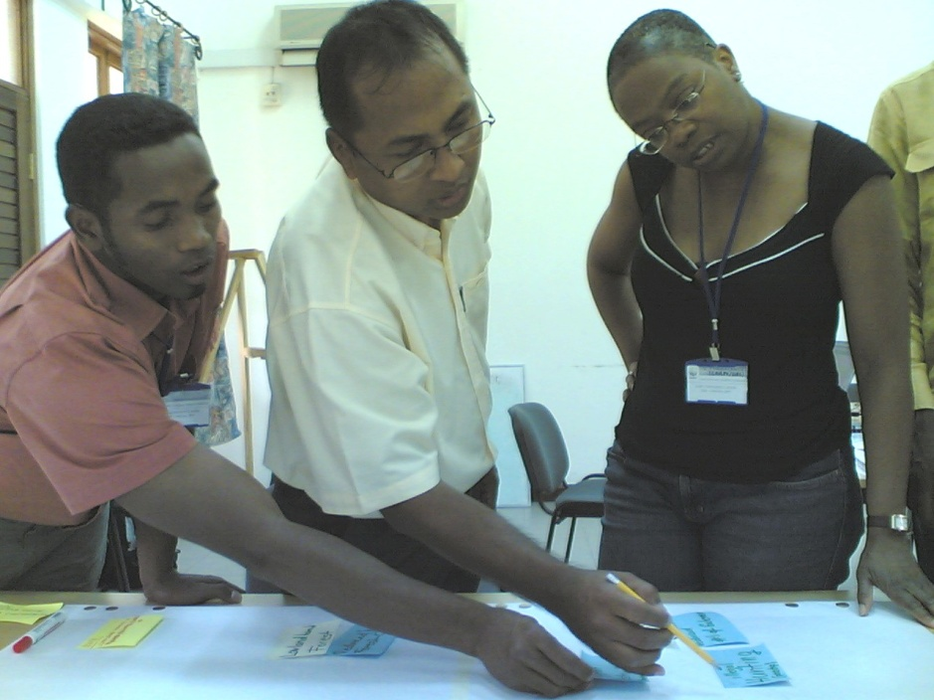
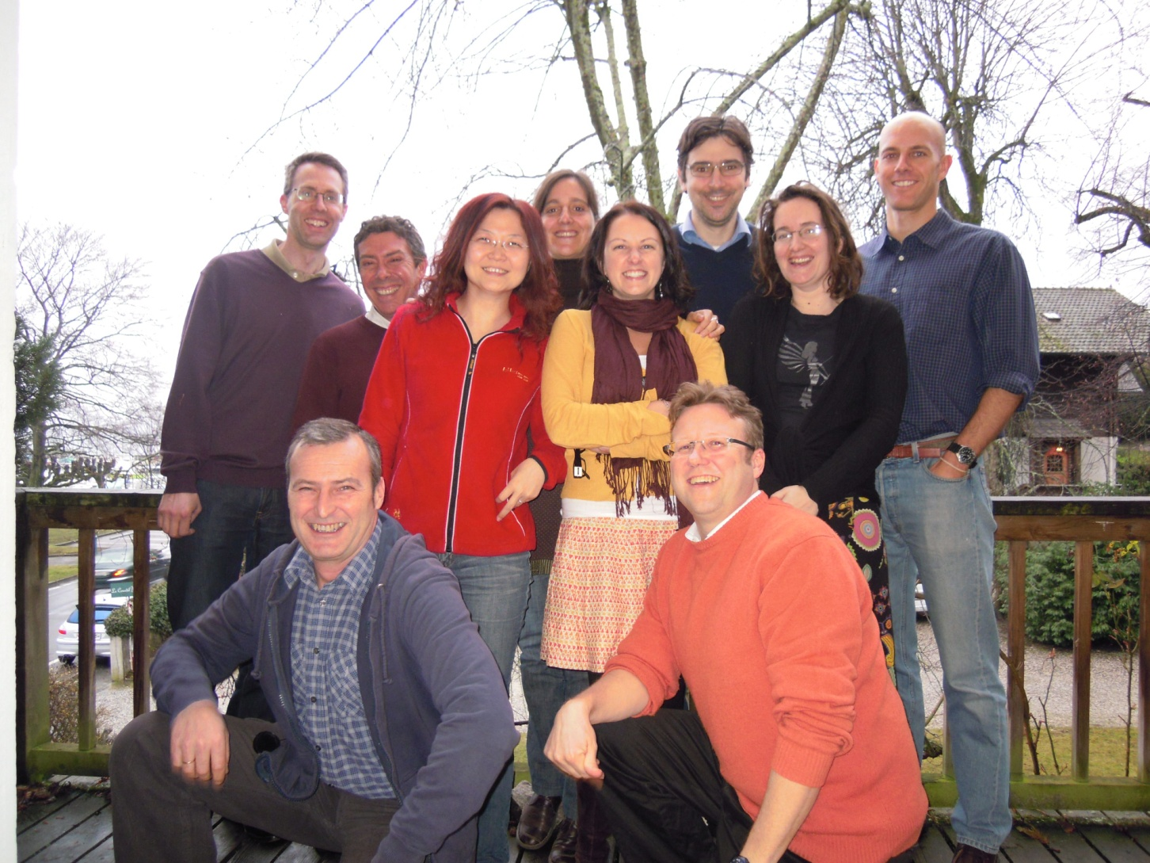
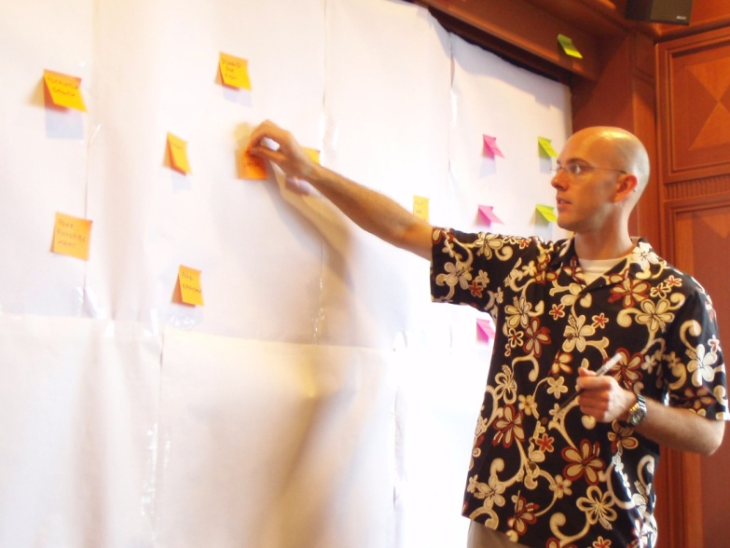

Slide 12
The role of coaches: addressing the challenges
Solid planning and programme design to ensure success
  Ensure root causes are addressed (conceptual models)
  Factor in climate change adaptation and socio-political drivers to programme design
  Ensure conservation at scale
  Engage stakeholders
Demonstrate impact and value of conservation work
  Good m&e at different scales (impact, peformance, value)
  Lesson learning and sharing
  Adaptive management to replicate successes
Help keep standards relevant and applicable

Slide 13
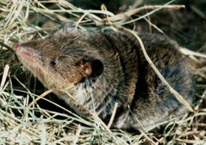
The role of coaches:
two asks
Good models of best practice, especially for strategic plans and monitoring systems, and projects that follow standards through the whole cycle
More evidence of what we know: better practice leads to better conservation
© PJ Stephenson
Notes:
If we can get these then constant issue of SMT buy in will disappear without any more lobbying; convince the science teams it’s worth the investment

Slide 14
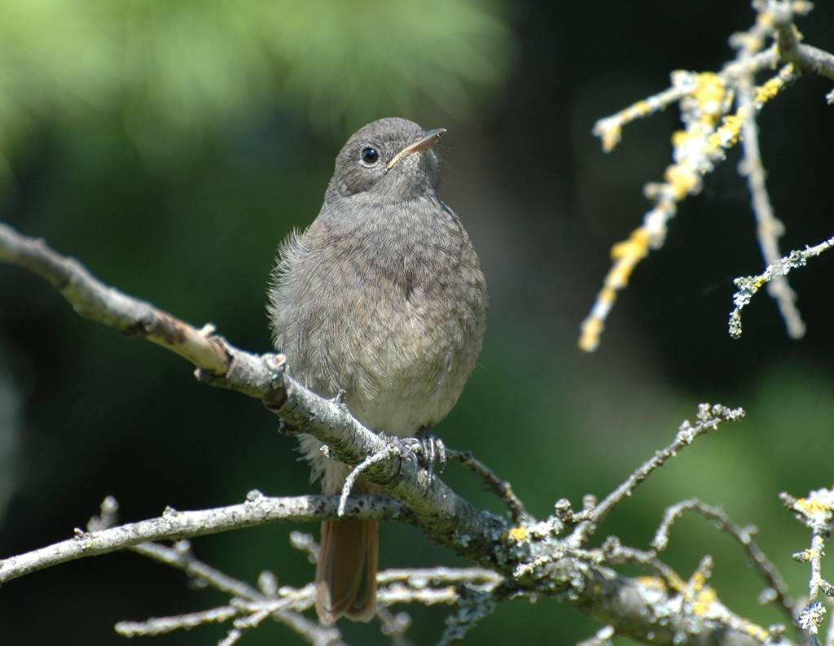
© PJ Stephenson
© PJ Stephenson
Notes:
In a nutshell, to reverse the environmental trends we need to develop large ambitious programmes that tackle root causes and demonstrate an impact: coaches will play a vital role in doing that. CCNET is a great mechanism to ensure we build and grow and enhance our capacity so that together we can improve best practice and do better conservation.

