Slide 1
Conservation Action Planning (CAP) Process
“Thinking like a conservationist”
Quick Tour
Project-level planning & measures within
The Nature Conservancy
Notes:
Thank you for inviting us to share this conservation planning approach.

Slide 2
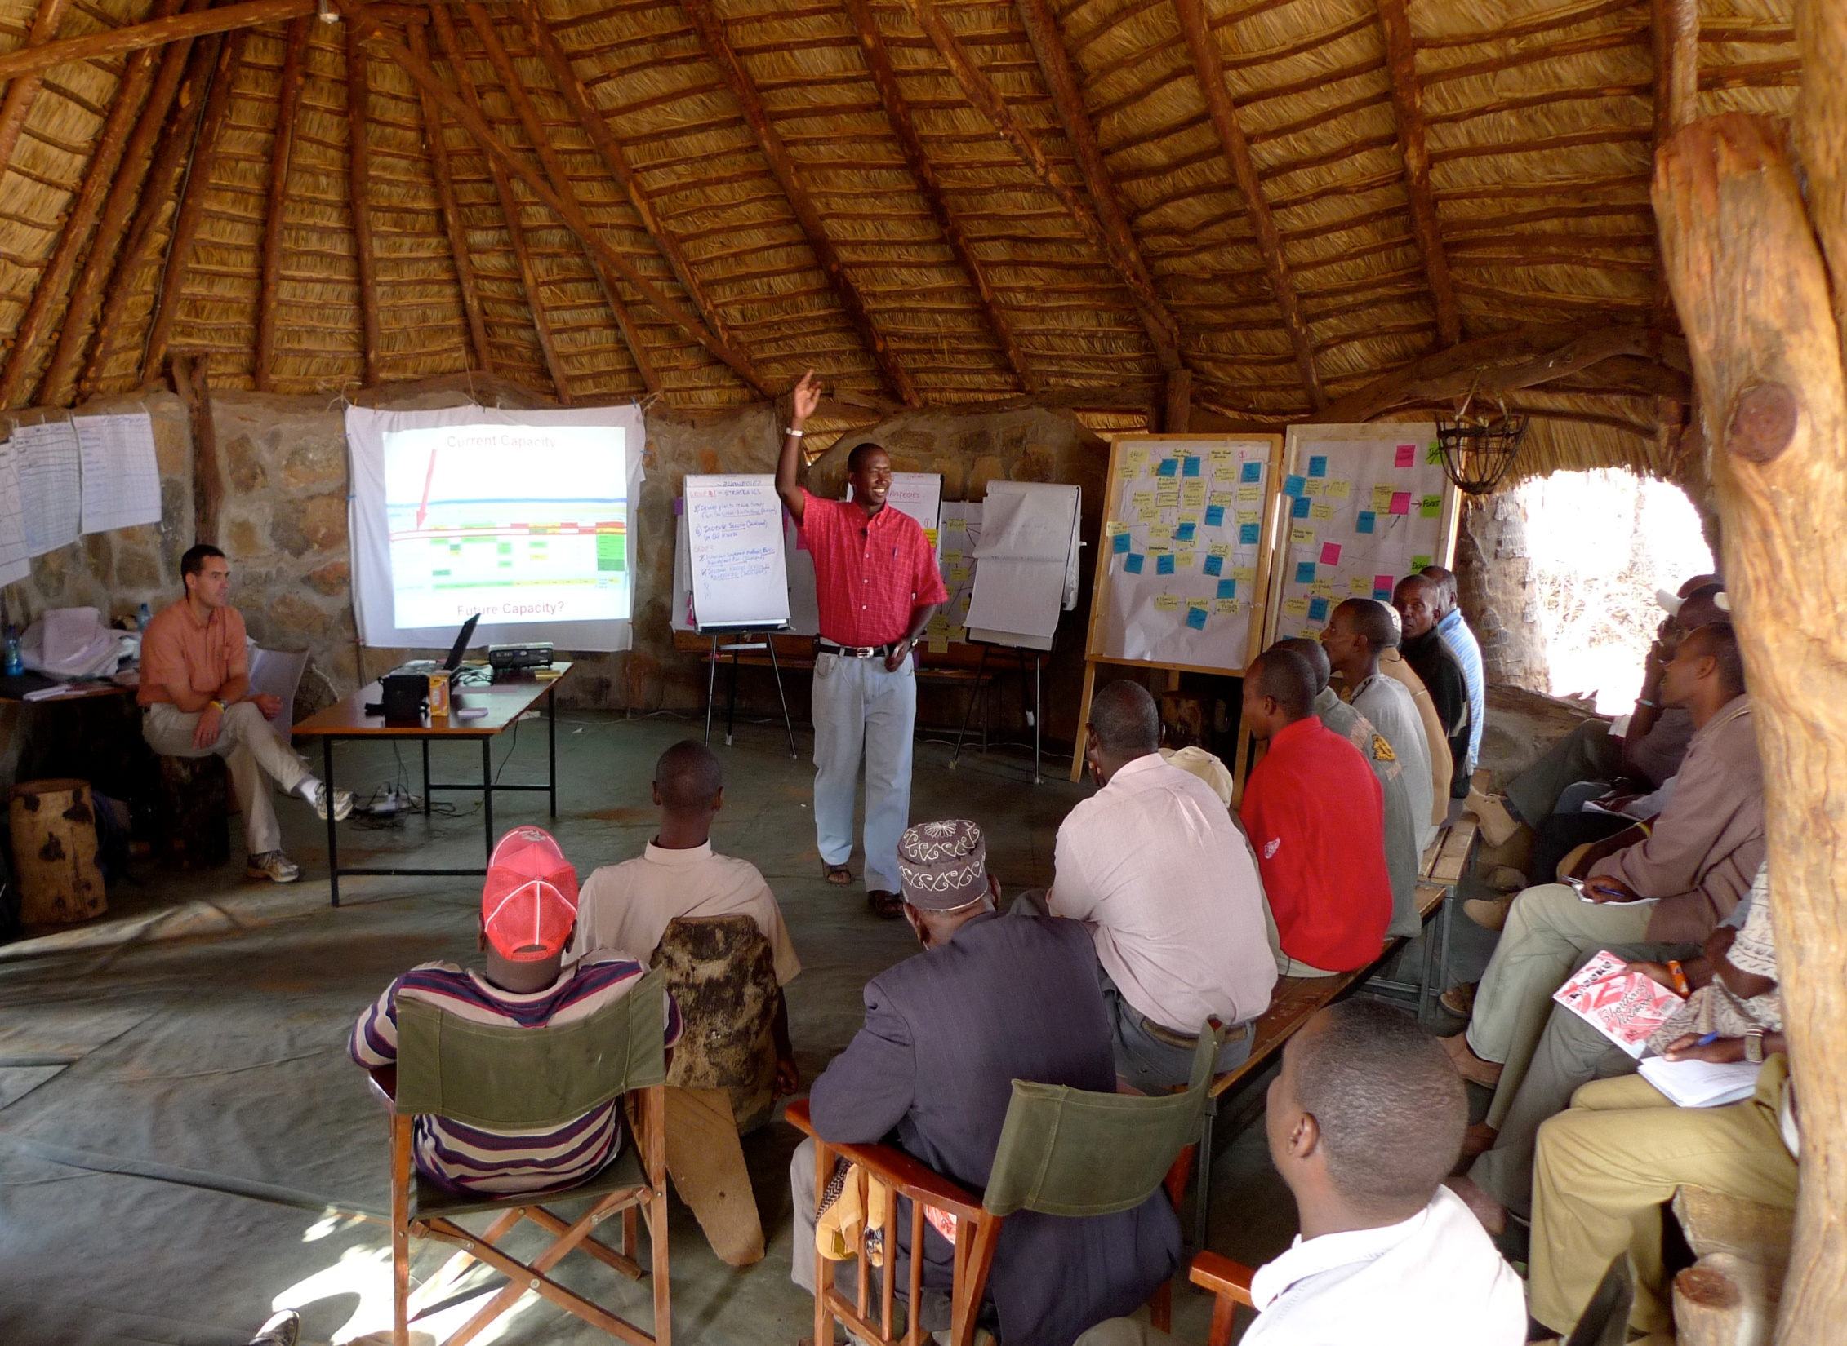
CAP Stories from around the World
Why we like CAP
Northern Kenya Rangelands
Notes:
Tribal leaders and local people across adjacent 2 million acres of communal lands are coming together to develop a shared approach to managing the precious forage, wildlife resources and water that they all depend on using this method. And as one tribal leader said “The CAP workshop has shown us how to move forward. By setting priorities with our neighboring conservancies, there is real hope that we can make progress.” (they call their collectives “land conservancies”.)

Slide 3
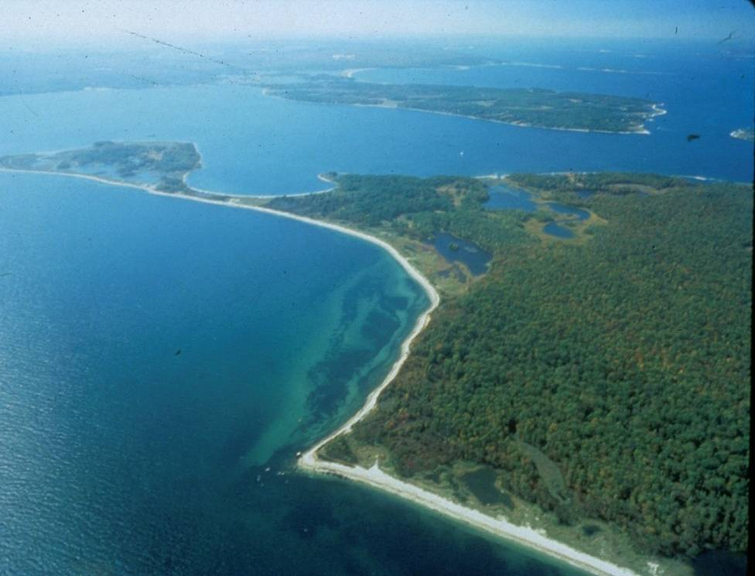
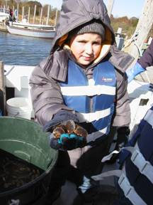
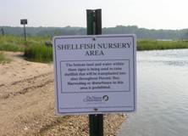
Peconic Estuary, New York
Notes:
In the Peconic Estuary,
Oystermen, fishermen, Town councilors, NGOs got together using CAP to forge a plan for their estuary and now …..new scallop spawning sanctuaries have been created and scallop harvest regulations have been modified.
Baymen and Long Island towns have banded together to fund the purchase of clams to release into the new sanctuaries
And the Scallop and hard clam populations are increasing in the Estuary.

Slide 4
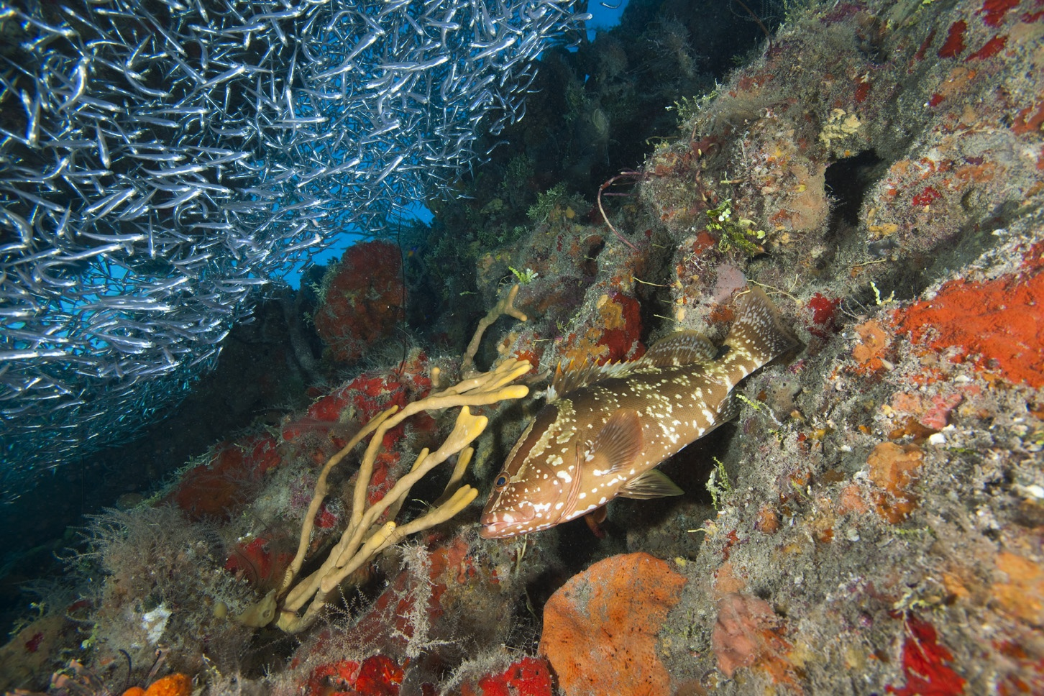
Mesoamerican Reef
Notes:
At the Cayos Cochinos National Monument, Fisherman, tourism operators, government and NGO representatives hadn’t even finished their Protected Area plan which used the CAP framework and the group had all agreed to and pushed for expansion of the sanctuary boundaries to include four critical spawning areas.
The process revealed clearly for all to see that it was in all of their best interest to protect his additional area in the sanctuary.

Slide 5
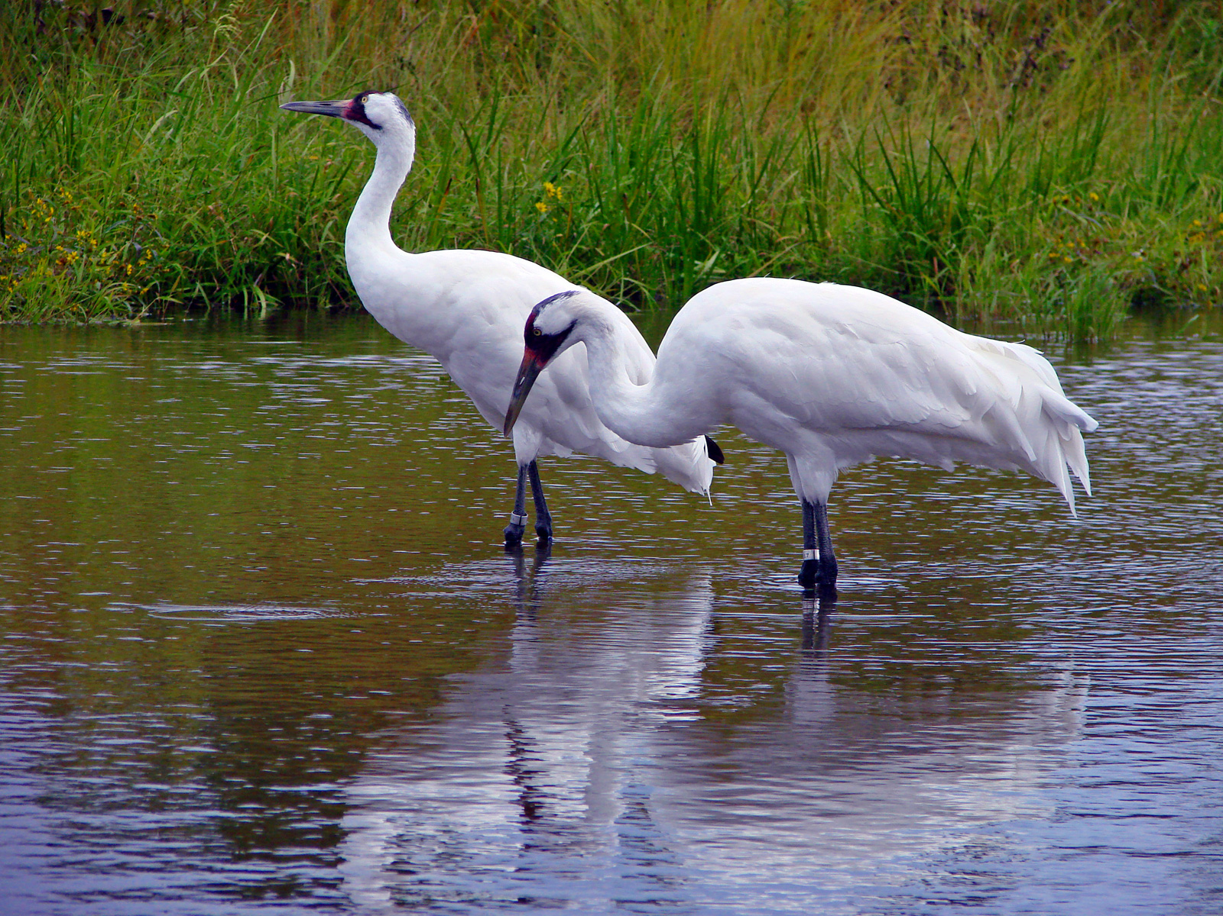
What do these two need us to think about if we are to have an
enduring conservation strategy for them and their children?
Notes:
When you now think about developing a shared conservation plan for this magnificent species --- what are some of the things you would want to have in your plan of action?
Let participants brain storm some components of a good action plan…..

Slide 6
Why Conservation Action Planning ?
To answer common questions and forge shared direction
Notes:
This approach we are about to start together will help you to gather all these components together…. Lets see how it works

Slide 7
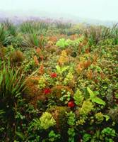
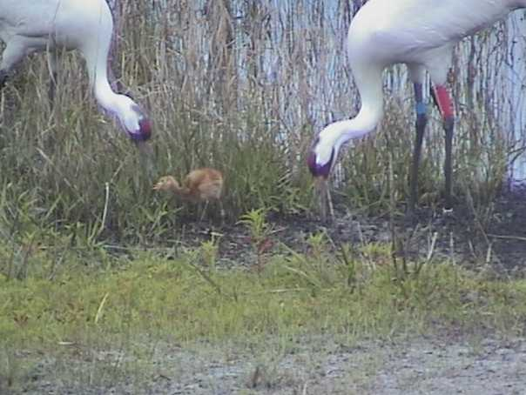
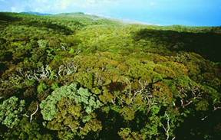
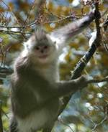
CAP answers
common key questions
What is the biodiversity we care about and what is our best estimate of how it’s doing?
Viability Summary
East Molokai
Targets |  | Landscape Context | Condition | Size | Viability Rank
1 | North Shore Forests & Cliffs | Fair | Good | Fair | Fair
2 | Montane Wet Forest | Fair | Very Good | Fair | Good
3 | South Slope Mesic Forest & Shrubland | Poor | Good | Poor | Fair
Overall Biodiversity Health Rank |  |  |  |  | Fair
Notes:
The CAP approach asks us to consider:
What is it we want to conserve?
What is our current best understanding of what these things need to be “healthy”?
What condition is our system in right now?

Slide 8
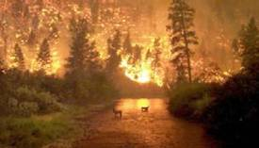
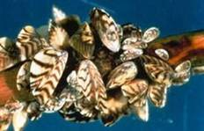
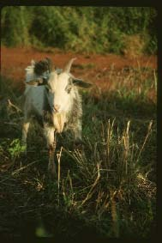
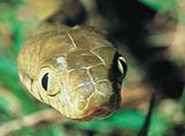
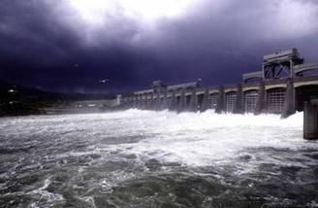
CAP answers
common key questions
What threats are creating problems for the biodiversity we care about and what is the estimated seriousness of these threats?
Notes:
The method asks us to consider:
What is challenging the things that we care about and what is likely to be a challenge as we look into the future?
What is the intensity and scale that these threats operate on?
Can we reverse the impact once it is perpetrated?
We may use some words that are new to you as we go through this process. But none of these concepts will be new to you. They are all pretty obvious and intuitive. So, please, don’t get thrown by any of the terminology.

Slide 9
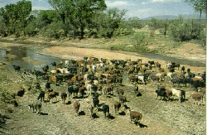
CAP answers
common key questions
What specific outcomes are we trying to achieve?
Instead of “reduce impacts from cattle grazing”
By 2010, maintain cattle-free conditions within 100 ft of 75 miles of Willow River.
Notes:
The method encourages us to build measurable objectives based on what we understand about the viability of the system and the nature and scale of the threats.
In this example, the riparian forest is needed to sustain adequate breeding habitat for a native flycatcher. The science tells them that the birds need at 100 ft. width of forest along 75 miles of river to have a successful breeding population. It was establishing the target and understanding what it needs to be viable and what its threats were – that enabled them to set a specific measurable objective.
You can see that this objective can really shape their actions.

Slide 10
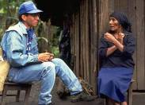
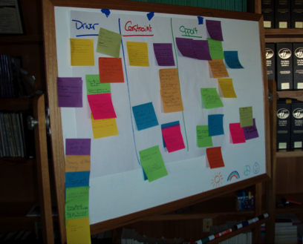
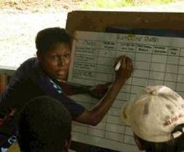
CAP answers
common key questions
Who are the key stakeholders with vested interest in these targets, threats? What factors are driving threats?
What opportunities should be pursued?
Notes:
Next you are prompted to consider:
What is the underlying situation that drives and shapes the threats and presents the conditions in which strategies must act?
Who is driving the threats?
Why?
What do they need?
What opportunities may be there to reverse the situation or engage others?
These are the kinds of questions you will be looking at this step.

Slide 11
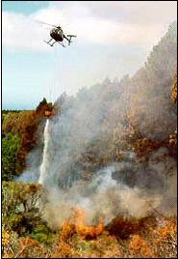
CAP answers common key questions…….
What actions are needed to achieve the desired outcomes?
# | Objectives and Strategic Actions
Objective | By 2012 area under native vegetation increased by 15,000ha (based on 33% total area as minimum)
Strategic action | Develop spatially explicit landscape plan which identifies key areas for implementation of all strategies
Strategic action | Purchase properties that most effectively deliver G-Link's ecological outcomes
Strategic action | Restore native vegetation systems on geographically and ecologically suitable sites
Strategic action | Develop inclusive fire management strategies to manage mosaic values on all land tenures
Notes:
What can we do??
This step prompts us to lay out a plan of action so that we have at least some thought through steps to take – not just theoretical.

Slide 12
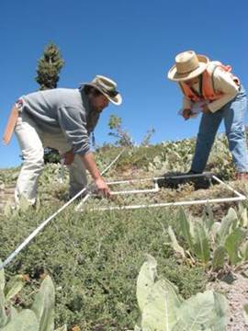
CAP answers common key questions……..
How do we know if our actions are working?
# | Objectives and Indicators
Objective | By 2012 area under native vegetation increased by 15,000ha (based on 33% total area as minimum)
Indicator | % of pre-European extent
Indicator | percentage of catchment with perennial vegetation cover
Indicator | Representative native species present
Notes:
The method provides built in set of metrics that can be modified and used to set up measures that will enable us to assess our progress, adapt and learn.

Slide 13
What do we like about CAP?
SIMPLE
FLEXIBLE
Developed for CONSERVATION PROJECTS
Promotes FOCUS
Helps us prioritize ACTIONS
Promotes ACCOUNTABILITY
Can COMMUNICATE AND COMPARE
USEFUL SOFTWARE
Notes:
SIMPLE – at its core. Yet allows user to go much deeper if information and skill allows.
FLEXIBLE. Can be used for small site, large landscape, region, or “issue” e.g. invasive species.
Developed with BIODIVERSITY EMPHASIS yet adaptable for use with other resource related targets. E.g. cultural targets, Rural family lifestyle.
Promotes FOCUS. Drives user to focus on what they really want to accomplish and what is really standing in their way and what they are really going to do about it tomorrow.
Promotes ACCOUNTABILITY. Provides multiple points of entry to ask the question: How are we doing?
Provides means to COMMUNICATE AND COMPARE across sites, continents, organizations.
Added bonus – SOFTWARE!

Slide 14
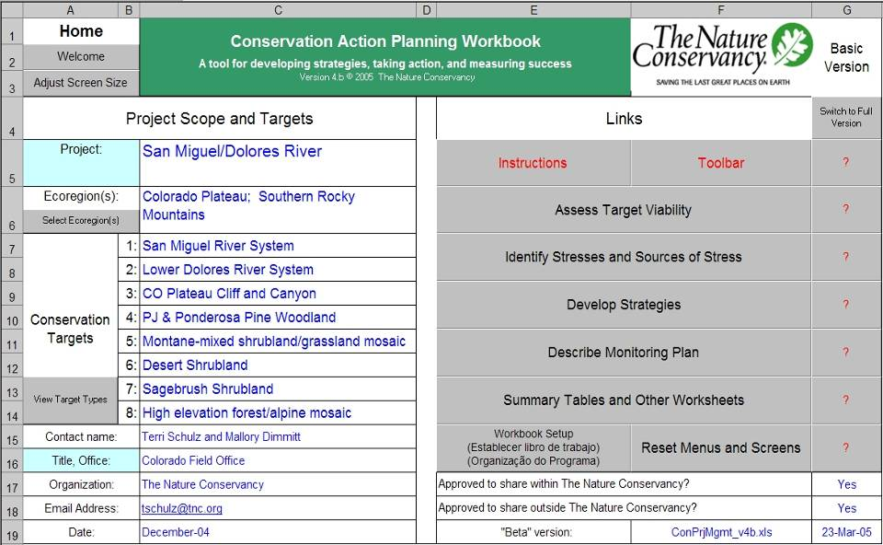
Excel Tool
Notes:
There are two different software programs that enable you to capture your plan.
The Excel spread sheet that can be a useful way to store your ideas and also has some nice roll-up sheets that can “calculate” what you tell it and then give you “scoring sheets” that characterize your projects more critical threats and biodiversity status among other things.
But the spread sheet isn’t the technique. The technique is a way of thinking really.
The spread sheet can just help you to see your ideas in red and green

Slide 15
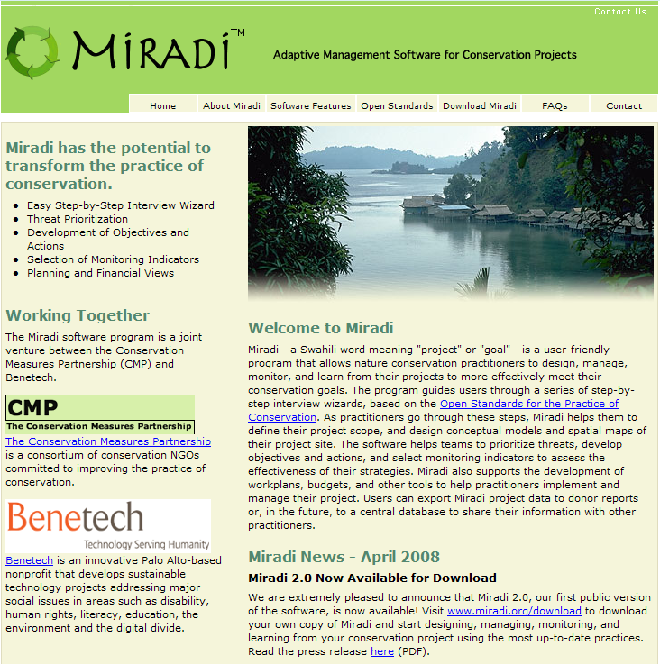
Notes:
TNC has been working with the Conservation Measures Partnership on a new desktop tool for project cycle / adaptive management planning and measures called Miradi which can also be used to capture your Conservation Action Plan.
The Miradi software package is laid out differently than the excel spread sheet.
But the method is the same and the software has a built in tutorial on the method and provides a means to easily capture and record your ideas and information and develop a work plan and budget for your project.
Both of these software packages help us to record our shared work and capture our assumptions.
Another value of these agile products is they enable us to compare our work from time to time and place to place.

Slide 16
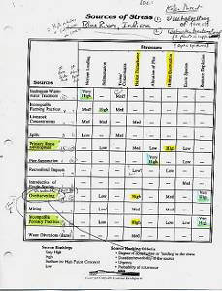
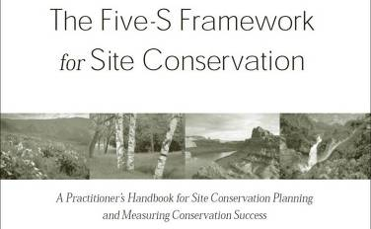
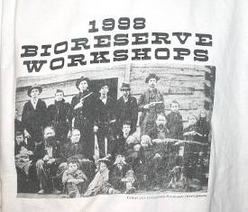
More than 20 years in the making!
From humble beginnings…………
Notes:
This method has been evolving for more than 20 years in TNC.
It started in the mid-1980’s when we shifted from small nature sanctuary type of conservation to thinking about the larger landscapes in which these places are embedded. When we started to see that you can’t just buy a 50 acre tract of land to protect rare mollusks in a river you have to deal with the watershed.
We started asking “well how do these things work and what are the “threats’ to these mechanisms”.
The method has had many names over this time….5S, Site conservation planning, bioreserve planning, conservation area planning, E5S and Conservation Action Planning…..
It has been changing ever since and continues to evolve.

Slide 17
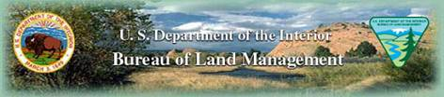

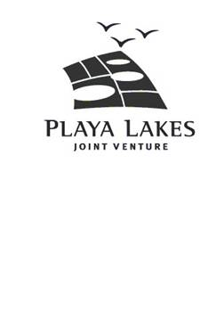





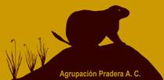



With Input from 100’s of Partners
  From over 900 projects from six continents
Notes:
Today, 100’s of partners have been engaged in CAP planning from all over the world. All kinds of partners and Conservation practitioners from six continents have been using the method and all them adapting and modifying the simple technique for their situations.

Slide 18
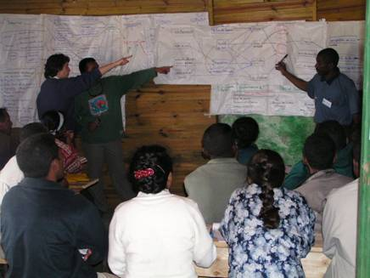
CAP Around the World
Bolivian Government
Greening Australia
Thailand – Western Forest Complex
Pronatura – Mexico
Gombe Reserve - Jane Goodall Institute
Guatemala – Tikal, Atitlan National Parks
Serengeti National Park
Peru - Machu Piccu
Kamchatka – Kol River salmon
BLM – western US, NOAA Salmon Recovery Planning
And more………
CAP Coach training Madagascar National Parks staff
Notes:
Just a sample of the many places worldwide…..

Slide 19
Some interesting adaptations!
Variations on a Theme
US State Wildlife Conservation Plans
Endangered Species Recovery Plans – Bog Turtle, Desert tortoise
Archeological and cultural target conservation planning in Central and
South America
Participatory conservation planning with indigenous and
local community people – Indonesia, Amazon, Texas, Solomon Islands, Northern Territory - Australia
Notes:
The method is constantly being adapted

Slide 20


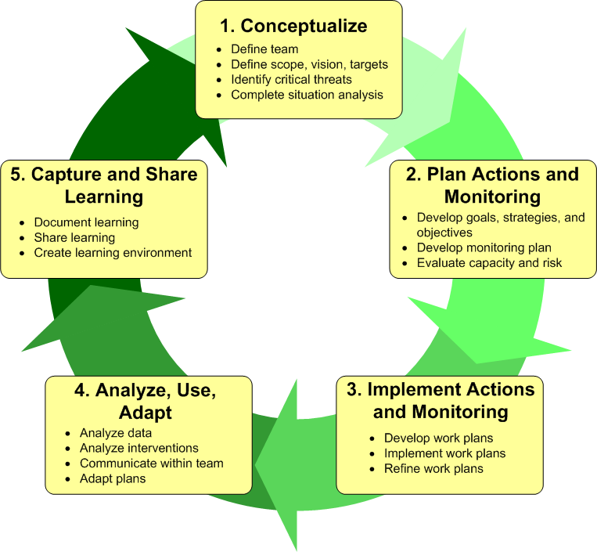









Open Standards for Conservation Practice
www.conservationmeasures.org
Notes:
CAP is consistent with the Open Standards for Conservation Practice which has been adopted by over 15 major NGO’s and now some government agencies to harmonize our individual conservation approaches. So that we can learn and share across the greater conservation community with more agility.
This group of parties calls themselves the Conservation Measures Partnership.

Slide 21
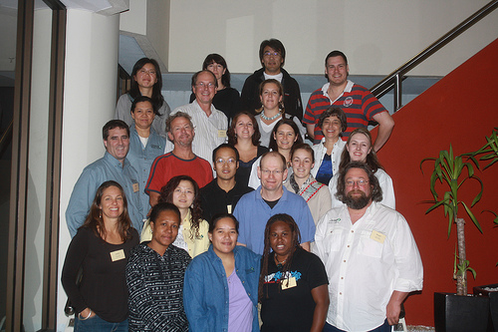
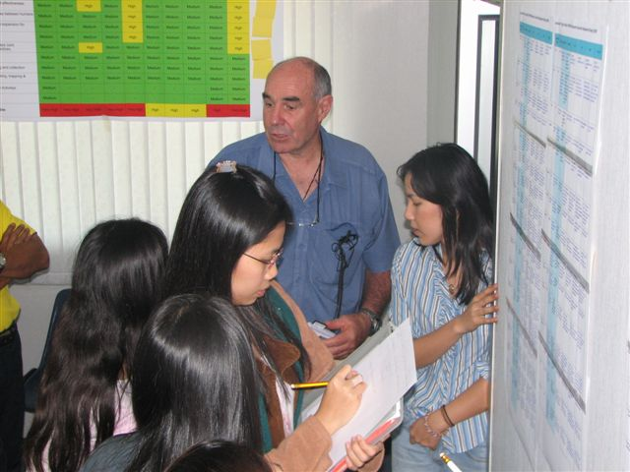
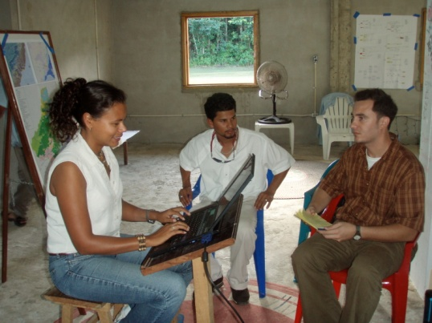
Supporting focused conservation practice, sharing and learning worldwide, building capacity for the Future
The Conservation Coaches Network
Notes:
Because of the fact that we are harmonizing our approaches to conservation, we are able to help each other too.
The Conservation Coaches Network is a partnership enterprise that has been established to train and support coaches whose primary role is to support conservation teams in the successful adoption and execution of CAP/Open Standards to their projects to generate effective conservation strategies everywhere we work.
Today there are 260 coaches operating across 25 organizations.
The coaches also commit to connecting with each other to share and learn about what works and to enhance their skills support teams.

Slide 22
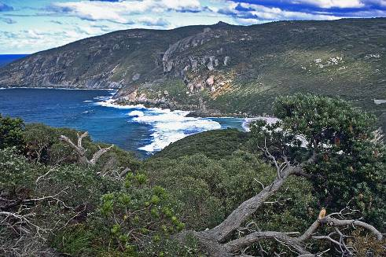
Core Purpose of Coaches Network
Priority projects have effective action plans producing results at real places.
Notes:
The coaches work in the spirit of fellowship to promote the best possible conservation outcomes all over the world.

Slide 23
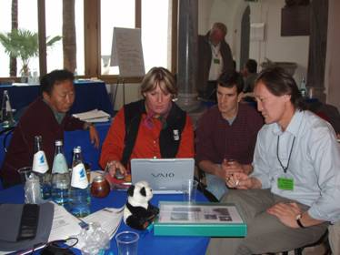
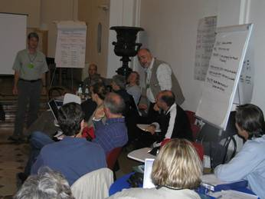
Peer Review Workshops
Coaches Facilitate……..
  What is this?
  Multiple teams working on their CAP side-by-side and providing each other peer review and input
Notes:
Efroymson approach again
Learn by doing
Minimal lecture
Lots of activity
Best when there is more than one site
But large sites – broken up into working teams by target or other devise proving to be a good method too

Slide 24
Ground Rules
Participate
Don’t Dominate
Tough Love… but
“Boss-Free Zone”
Everyone advocates; project team decides
Cell phones/e-mail off; no side conversations
Have Fun
Notes:
In every fellowship workshop we like to establish some shared ground rules.
The rules are pretty simple:
Everyone has an important piece of the puzzle to share here so everyone is urged to participate, don’t hold back.
But at the same time, make time for others by not dominating the conversations.
We are all here because we want to make the best possible course of action to achieve the best possible outcomes, so we should feel safe to challenge and push each other’s ideas. But to do so with respect for each other.
“boss free zone” means that even if you report to someone in this room, lets all be here as equals. No high or low. Everyone’s perspective needs to be shared and heard.
That said, at the end of the day the team that has to make these actions work in real places on the ground has the final word. So we urge the team to listen to all ideas. To be open not defensive to all “tough love”, consider the questions that others have. But at the end of the day, you will know what will make sense for your project.

Slide 25
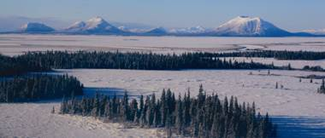
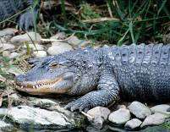
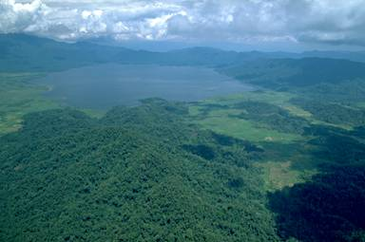
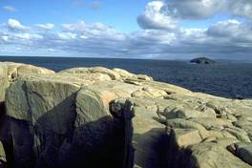
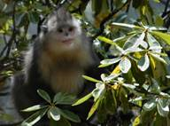
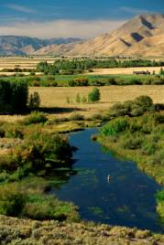
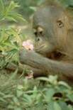
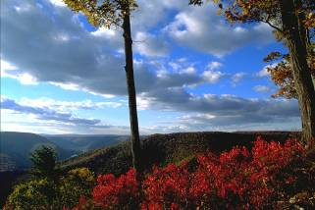
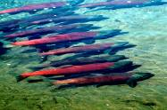

Great conservation at Great Places!
Notes:
This process has one aim and one aim only – to get conservation work done in real places on this earth.

